Slide 1
Spring 2021 School Counselor Forum Division of Public Schools
Felicia M. Trumpler, School Counseling Consultant
Bureau of Student Support Services
Notes:
Good morning everyone and thank you for joining us! I am Felicia Trumpler with the Bureau of Student Support Services here at the Florida Department of Education in collaboration with the Student Services Project at USF.

Slide 2
Today’s Agenda Student Progression Updates Advanced International Certificate of Education (AICE) International Baccalaureate (IB) Career and Professional Education Act (CAPE)/Career and Technical Education (CTE) Career Readiness in Secondary Schools IDEA and Secondary Transition Florida Standards Assessments and Students with Disabilities Dual Enrollment and Articulation Bright Futures Medicaid in Schools School Health IEP Updates, 504 Reminders and Timelines Mental Health Support in Schools
Notes:
We have a great lineup for you this morning, which will include a Q & A session towards the end of the presentation. If for any reason we cannot provide you with a response today, we will be more than happy to take your question and get a response to you later. Let’s get started!
Housekeeping-This is just a reminder to place yourselves on mute.

Slide 3
Student Progression Updates
Felicia M. Trumpler, M.A. Ed.
School Counseling Consultant
Felicia.Trumpler@fldoe.org
850-245-0457

Slide 4
Emergency Order 2021-EO-02
In an effort to assist school districts in providing a continuum of quality education, while promoting parental choice, the following information on Emergency Order 2021-EO-02 is available. This order provides great flexibility to school districts, while meeting the educational needs of all learners.
Guidance within this order covers graduating seniors, retention, waivers and so much more. We encourage you to review these documents with your district leadership.
Florida Department of Education (FDOE) issues Emergency Order (EO) 2021-EO-02
FDOE issues Emergency Order (EO) 2021-EO-02 - Slide Deck
FDOE issues Emergency Order (EO) 2021-EO-02 - Webinar Recording
Access at: http://www.fldoe.org/em-response/ index.stml

Slide 5
Resources
Secondary Student Progression Frequently Asked Questions
This resource includes the following:
Current legislative and Florida Administrative Code requirements;
Clarification and technical assistance related to the revision and development of student progression policies and procedures;
Helpful links to resources provided by FDOE;
Current law requires each district school board to establish a comprehensive program for student progression as well as standards for evaluating each student’s performance (section 1008.25, Florida Statutes [F.S.]).
Standard Diploma Requirements - What Students and Parents Need to Know (Revised August 2020)
Information related to statewide assessment requirements is available in Graduation Requirements for Florida's Statewide Assessments.
The Florida Counseling for Future Education Handbook is annually updated to provide school counselors and advisors with a comprehensive academic advising resource to guide students with planning for postsecondary education in Florida.
Dual Enrollment Frequently Asked Questions
Dual Enrollment High School Course Equivalency Academic List

Slide 6
Bill Tracking
How to track bills during the Legislative Session

Slide 7
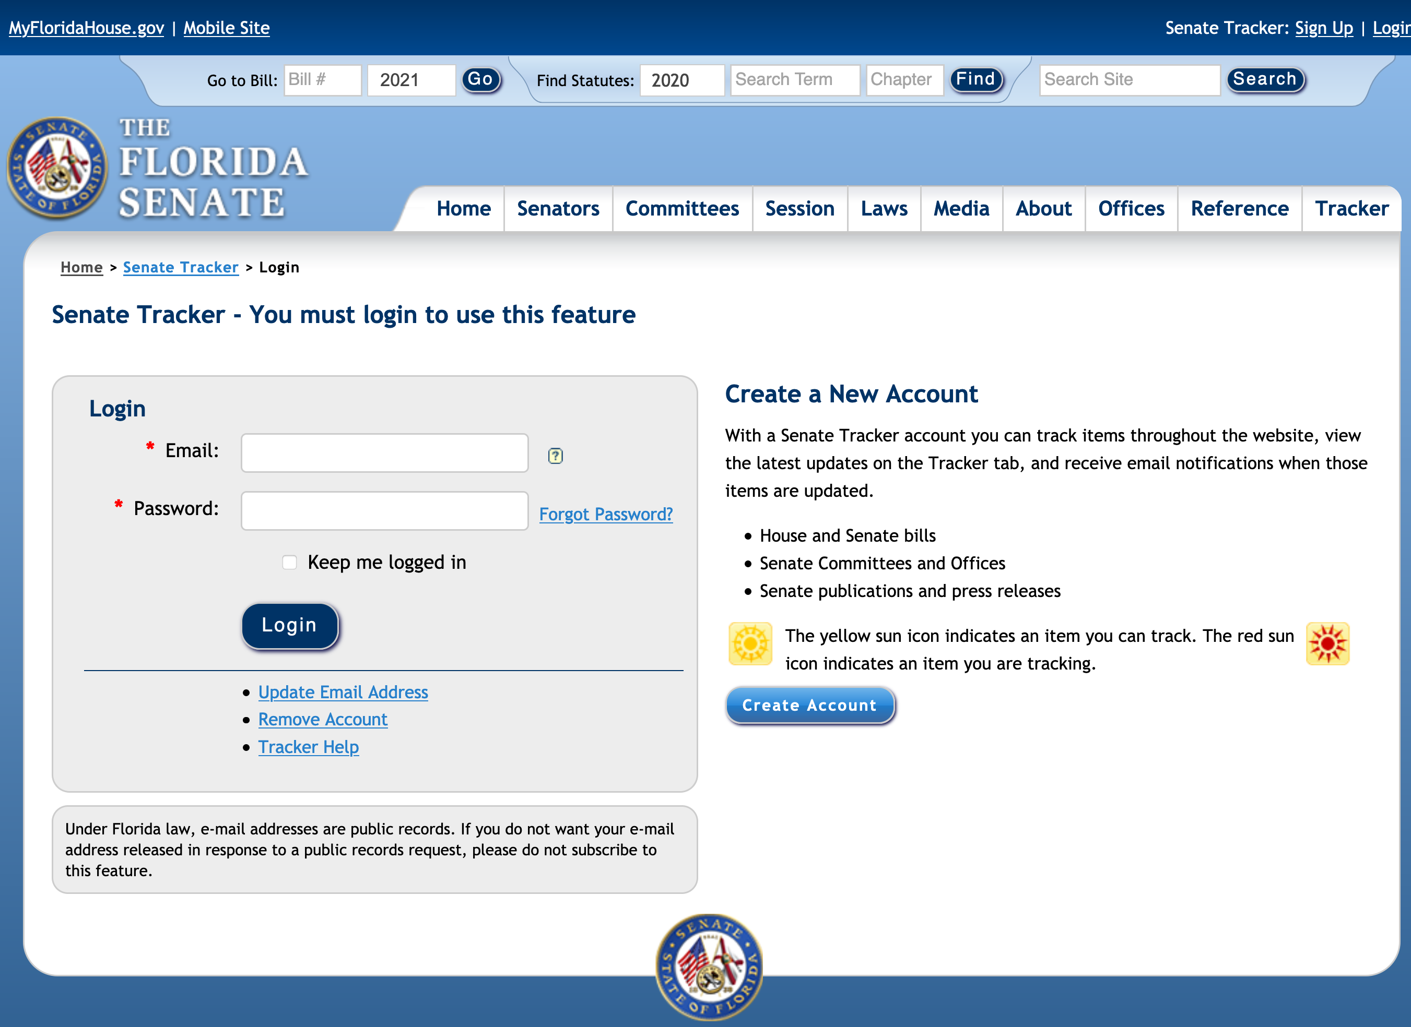
Go to www.flsenate.gov
Felicia.Trumpler@fldoe.org
••••••••••
Notes:
Go to www.flsenate.gov

Slide 8
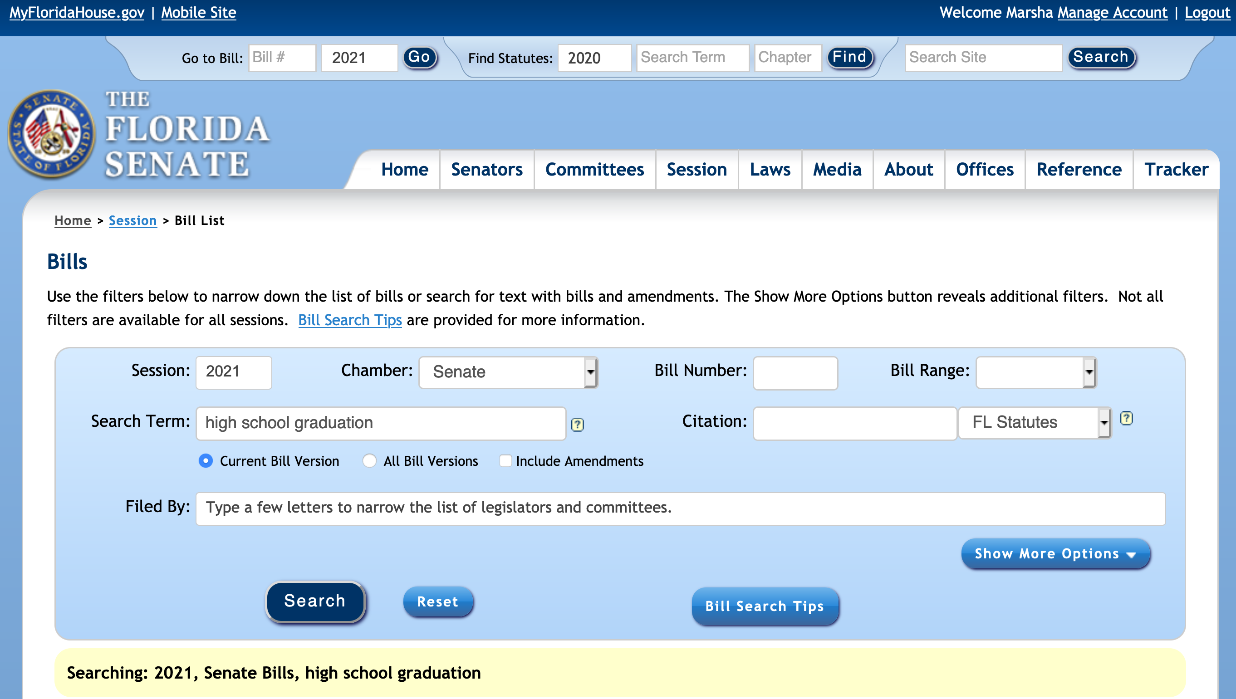
Step 1: Once logged in, click on the tab at the top of the page that says “Session.” A drop-down menu will appear. Select the “Bills” option.
Step 2: In the “Search Term” box, type in the desired term to search (i.e., education). Options from the search will begin to appear.

Slide 9
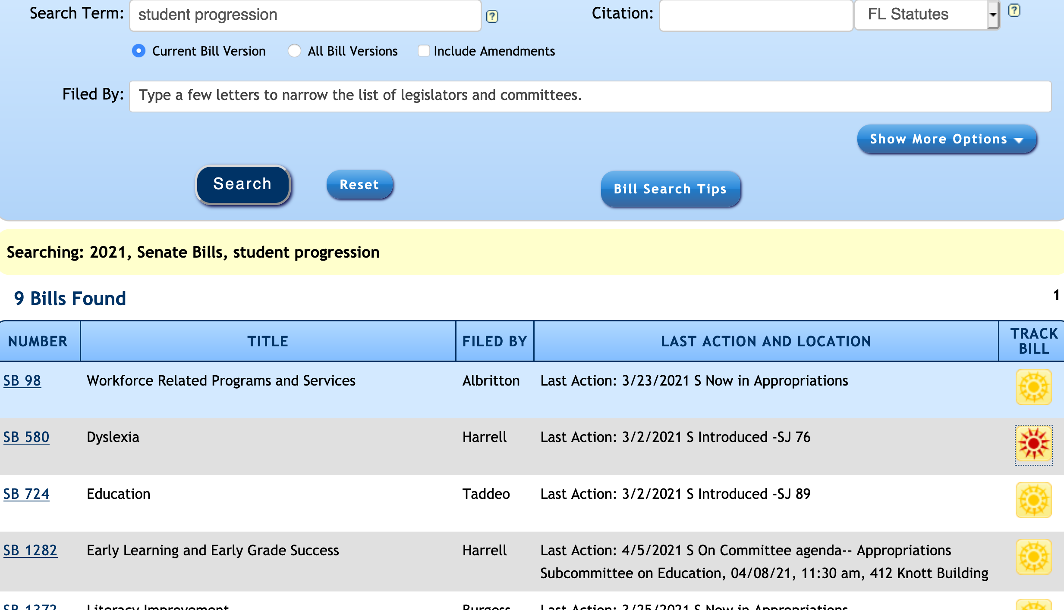
Step 3: Once the desired search has generated a list, you may begin selecting the bills you wish to follow.
NOTE: The bills you wish to select will have a tracking symbol next to them. Once you select it, the symbol will turn from yellow to red.
Tracking Symbol
Following

Slide 10
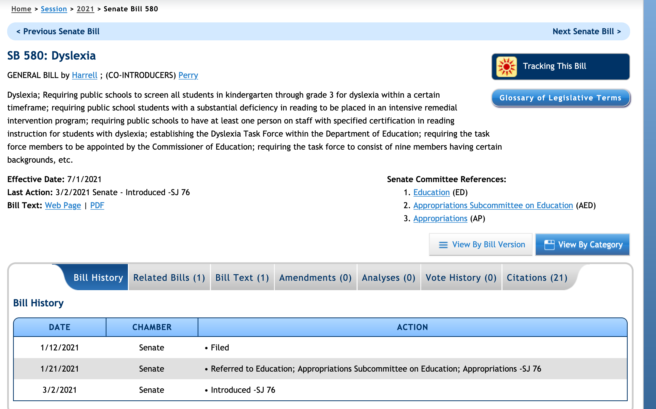

Slide 11
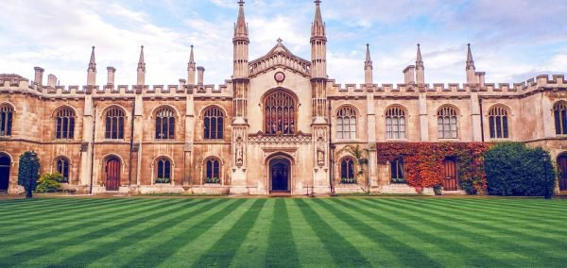
Cambridge Advanced International Certificate of Education (AICE) Diploma and Curriculum Overview and Updates
Sherry Reach, Deputy Regional Director, North America
sherry.reach@cambridgeinternational.org
Notes:
Up next, we have Sherry Reach to provide AICE updates

Slide 12
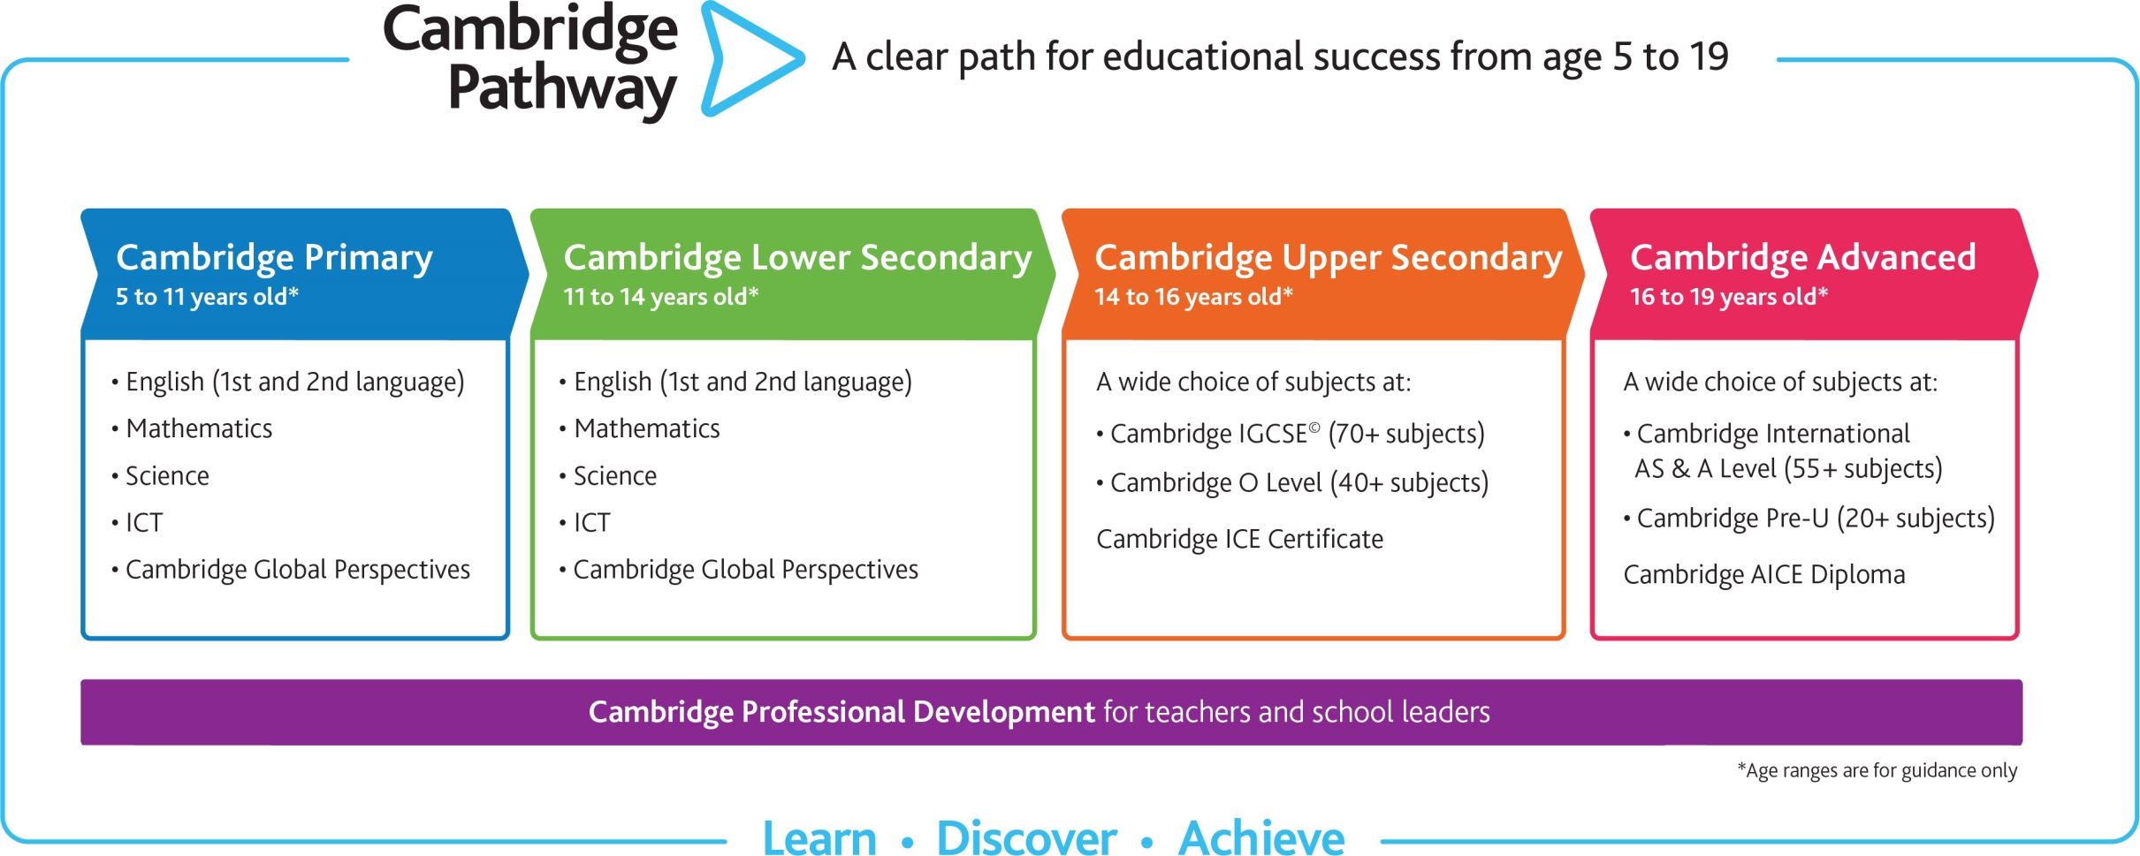
The Cambridge Pathway to an AICE Diploma
Grades K - 8
High School Pre AICE (IGCSE) and AICE (AS / A levels)

Slide 13
Teaching and Testing support for schools during the COVID-19 Pandemic
Information available on our website here:
https://www.cambridgeinternational.org/covid

Slide 14
Cambridge AICE Diploma Subject Groups and CORE
Cambridge AICE Diploma Core: AS Level Global Perspectives and Research (components 1, 2 & 3)
Group 1 Mathematics and Science | Group 2 Languages | Group 3 Arts & Humanities | Group 4 Interdisciplinary & skills-based subjects
Biology Chemistry Computer Science Design & Technology Environmental Management Further Mathematics Information Technology Marine Science Mathematics Physical Education Physics Psychology | Afrikaans Language Arabic Chinese (Mandarin) English Language First Language Spanish French German Hindi Language & Literature in English Japanese Language Portuguese Spanish | Accounting Art & Design Business Classical Studies Digital Media & Design Drama (NEW!) Economics Environmental Management Geography History Language & Literature in English Literature in English Media Studies Music Physical Education Portuguese Literature Psychology Sociology Spanish Literature Travel & Tourism | Thinking Skills English General Paper Research Report (A Level Global Perspectives & Research component 4)* *Note: Subject Group 4 does not include the compulsory CORE AS Level Global Perspectives and Research components 1, 2 & 3. Subject Group 4 only includes GPR’s component 4: Research Report.

Slide 15
AICE Diploma Requirements
AICE Diploma Requirements
Combines breadth of study with choice and flexibility Selection comes from three curriculum areas and one Core Total of 7 points required: at least one from Groups 1-3; one from Core; three from learner’s choice Passing scores are required on all exams to receive Diploma
Group 1: Science and Math
Core: Global Perspectives and Research
At least 1 point
Group 2: Languages
4 Required
+
3 Choice
=
7 points
At least 1 point
Required: 1 point
Group 3: Arts & Humanities
At least 1 point
Cambridge AICE Diploma

Slide 16
AICE Diploma vs. AICE Curriculum
AICE Diploma
AICE Curriculum
Pass all seven required end-of-course AICE exams within three consecutive years:
The Diploma Core: Global Perspectives and Research (AS level),
One from AICE Math/Science subject group,
One from Language subject group,
One from Arts & Humanities subject group,
Three from any subject group (maximum of two from interdisciplinary group)
Pass all seven AICE courses per AICE subject group requirements and take* all corresponding AICE exams:
The Diploma Core: Global Perspectives and Research (AS level),
One from AICE Math/Science subject group,
One from Language subject group,
One from Arts & Humanities subject group,
Three from any subject group (maximum of two from interdisciplinary group)
* Not required to pass all seven of the end of AICE course examinations.
AICE Diploma Pathways

Slide 17
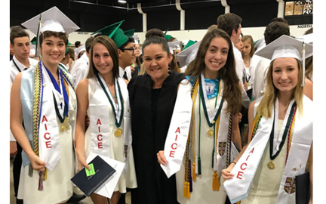
Florida Academic Scholar (FAS) Bright Futures Scholarship via AICE Diploma Award
Earn an AICE Diploma based on AICE exams taken prior to July of graduation year (or December if graduating midyear)
Complete the 100-hour community service requirement
Submit Florida Financial Aid Application
High School must submit student’s final transcript
(Exempt from ACT/SAT minimum FSA scores if awarded AICE Diploma)

Slide 18
FAS Bright Futures Scholarship via AICE Curriculum completion
Complete AICE Curriculum based on AICE courses and corresponding AICE exams taken prior to July of graduation year (or December if graduating midyear)
All AICE Exams do not have to be passed
Complete the 100-hour community service requirement
Submit Florida Financial Aid Application
Earn ACT/SAT minimum FSA score
Include 2000324 AICE curriculum completion course code on transcript

Slide 19
Florida Medallion Scholar (FMS) Bright Futures Scholarship via AICE Curriculum completion
Complete AICE Curriculum based on AICE courses and corresponding AICE exams taken prior to July of graduation year (or December if graduating midyear)
All AICE Exams do not have to be passed
Complete the 75-hour community service requirement
Submit Florida Financial Aid Application
Earn ACT/SAT minimum FMS score
High School must submit student’s final transcript

Slide 20
AICE Curriculum Completers
Completion of the AICE Curriculum is a pathway to a standard Florida high school diploma (s. 1008.4282, F.S.) – other pathways include 24 credits, 18 credits, etc.
Final high school transcript of AICE curriculum completers should include this course code:
2000324 AICE Curriculum course and Exam Completion
Course Credit: 0.00 Course Grade: T
Note: no action needed on transcript for students earning AICE Diploma prior to graduation

Slide 21
Common App and Coalition App now include Cambridge
EDUCATION > Current or Most Recent High School > Current or Most Recent Year Courses > Course Level
Cambridge Advanced (AS level) - use this for AICE courses
Cambridge Advanced (A level) - use this for AICE courses
International A level - (this is for international students)
Cambridge Pre-Advanced (IGCSE) - use this for Pre-AICE courses
International GCSE - (this is for international students)
Information about AS vs. AL assessment options can be found here:
https://www.cambridgeinternational.org/programmes-and-qualifications/cambridge-advanced/cambridge-international-as-and-a-levels/qualification.

Slide 22
Common and Coalition Applications
Testing > Tests Taken - click “yes” to self-report scores or future test dates (for test dates, simply put “June” or “Nov” and year)
Look for: (note there are drop-down menus under each of these)
Cambridge Advanced (A level) Subject exams (this is “AICE”)
Cambridge Advanced (AS level) Subject exams (this is “AICE”)
Cambridge Pre-Advanced (IGCSE) Subject exams (this is “Pre-AICE”)
Don’t use “> Additional Questions for International Students” section

Slide 23
Sending AS/AL exam results for credit and placement
New online system for transcript requests
Should make everyone’s life easier
Key is to wait until after February 21 senior year to make request
Students’ results prior to senior year will be sent within 28 days of request
Second report with end of senior year results will be sent when results released in August
https://gradetranscripts.cambridgeinternational.org

Slide 24
International Baccalaureate (IB) Updates
Florida Association of IB World Schools
Ralph Cline
FLIBS Executive Director
Ralph.Cline@flibs.org
850-597-0671
Karen Brown
FLIBS Governmental Liaison
Karen.Brown@flibs.org
850-597-0673

Slide 25
IB Data for 2015-2021
Year | # of IB Students Taking Examinations | Number of Exams Taken | % of Students Scoring 4+
2015 | 8553 | 30385 | 89.68%
2016 | 8724 | 30261 | 88.15%
2017 | 9083 | 31746 | 88.38%
2018 | 9210 | 32386 | 88.28%
2019 | 9148 | 31552 | 86.96%
2020 | 9135 | 31143 | 90.72%
2021 | 8925 | 30353

Slide 26
Changes to IB Assessment Routes for 2021
In November of 2020, the IB developed two pathways/routes for the formal assessment of student work based on a school’s, country’s or state’s individual circumstances with respect to COVID-19.
The two routes: a full assessment route and a non-examination route (similar to that in 2020). Both routes require evaluation of student work by external IB examiners.
There will be equality and equivalence between the results of both routes to ensure that there will be fair outcomes for these students in the global context.
Additionally, IB coordinators will still have the ability to file an Adverse Circumstance Appeal on behalf of individual students as they have in previous years.

Slide 27
IB’s Response to COVID-19 for 2021 and 2022
To help address the impact of COVID-19 on schools:
All new Diploma Programme (DP) courses scheduled for release in February 2021 were postponed and timelines for curriculum development in the DP for 2022-2024 were adjusted.
Virtual Professional Development formats have been introduced, and online workshop offers have been extended.
Additional school services have been converted into virtual/ remote formats, e.g., remote program evaluation through the 2021 calendar year, verification visits and the IB Global Conference.
Latest News and Updates:
https://ibo.org/news/news-about-the-ib/covid-19-coronavirus-updates

Slide 28
IB Curriculum Assessment Updates
First Assessments for new curricula in 2021
English Literature HL/SL
English Language and Literature HL/SL
Math Analysis and Approaches SL/HL
Math Applications and Interpretations SL/HL
First Assessments of new curricula for 2022
Theory of Knowledge
Economics SL/HL
Music SL/HL

Slide 29
IB Curriculum Review Schedule for 2022
The following subjects will have completed their review and the new syllabus for each subject will be taught beginning August-September 2022:
Business Management SL/HL
Classical Languages SL/HL
Digital Society (ITGS) SL/HL
Theatre SL/HL
Literature and Performance
Assessment for these new curricula will begin in May of 2024

Slide 30
Important Reminders for IB Counselors and Coordinators
Be sure that all demographic information is exactly the same for IB assessment registrations, school transcripts, Bright Futures applications.
CAS requirements are met in grades 11-12 and Bright Futures service requirement can be met in grades 9-12. Be sure to remind your DP students of the 100 hours of service required for Bright Futures.
All students planning to attend a state university must meet the “subject” credit requirements outlined in Board of Governors Regulation 6.002.

Slide 31
Florida Statutes that Relate to the IB
Funding:
Funds for operation of schools - s. 1011.62, F.S.
Articulation and Access:
Articulated acceleration mechanisms - s. 1007.27, F.S.
Graduation:
Requirements for a standard high school diploma - s. 1003.4282, F.S.
Diploma Designations:
Standard high school diploma designations - s. 1003.4285, F.S.
Bright Futures Awards ̶ Initial Eligibility:
Florida Bright Futures Scholarship Program; student eligibility requirements for initial awards - s. 1009.531, F.S.

Slide 32
What is Career and Technical Education?
What is Career and Technical Education (CTE)?
Presented by Pamela Gilman Health Science and Human Services
State Supervisor

Slide 33
Definition of CTE

Slide 34
The U.S. Department of Education, National Center for Education Statistics Defines CTE as:
In accordance with federal law (P.L. 115-224), NCES defines career and CTE as courses (at the high school level) and programs (at the postsecondary subbaccalaureate level) that focus on the skills and knowledge required for specific jobs or fields of work. The occupational fields included in this definition are: agriculture and natural resources; business support, management and finance; communications; computer and information sciences; construction; consumer services; education; engineering and architecture; health sciences; manufacturing; marketing; public, social and protective services; repair; and transportation.
Source: U.S. Department of Education, National Center for Education Statistics (2020)

Slide 35
CTE in Florida
17 Career Clusters
Middle schools, high schools, technical colleges, state colleges, adult education centers
Programs are reviewed on three-year cycles with industry input, per Florida Statute, to ensure the programs remain relevant in today’s market.

Slide 36
Where do students go after high school?
66% of 2019 high school graduates enrolled in college or university
Source: U.S Bureau of Labor Statistics (2020)

Slide 37
$28,598
The average annual price for
undergraduate tuition, fees, room and board
at a 4-year public university in 2018-19
$32,731
The average student loan debt
Sources:
U.S. Department of Education, National Center for Education Statistics (2020)
Federal Reserve (2021)

Slide 38
The Road to Careers
Students are faced with many decisions about their future. Some choose to go to college, but all must choose a career.
As counselors, how can you assist?

Slide 39
Benefits of CTE

Slide 40
CTE increases Graduation Rate
The high school graduation rate for CTE concentrators is 93%, compared to an average national freshman graduation rate of 80%.
Source: ACTE (https://www.acteonline.org/cte/#.Vg6FbysepNA)

Slide 41
Career and Technical Education
Provides students with the academic and technical skills, knowledge and training necessary to succeed in future careers and to become lifelong learners
Prepares students for the world of work by introducing them to workplace competencies in a hands-on context
Many quality programs offer a sequence of courses that lead to industry certification

Slide 42
Florida Bright Futures Scholarship Program
In addition to other requirements, students who complete at least three (3) courses in the same CTE program are eligible for the Florida Gold Seal Vocational (GSV) Scholars award.
GSV covers 100% tuition up to 72 credit hours for AS, AAS, CCC, PSAV or up to 60 credit hours for an ATD.

Slide 43
Industry Certifications
Make students more employable
Some articulate to college credit
Some may substitute for math or science credit
May earn the program and school district bonus FTE funding under the Career and Professional Education (CAPE) Act

Slide 44
Articulation Agreements
Industry Certification to AAS/AS Degree
PSAV to AAS/AS Degree
AS to Baccalaureate Degree

Slide 45
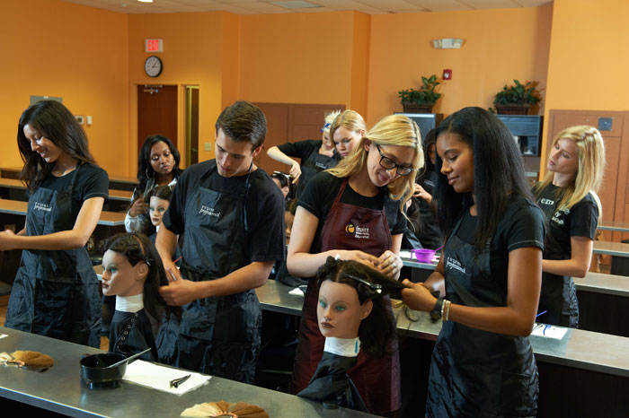
Practical Arts
342 CTE courses are designated as Practical Arts for graduation requirements for the 2019-2020 school year.
Examples:
3-D Animation
Cosmetology
Drafting
Digital Design
Game & Simulation Design
Robotic Design
Welding
And many more!

Slide 46
Economics Credit
Principles of Agribusiness
Agriculture Sales and Service

Slide 47
Equally Rigorous Science Credit
Many CTE courses count as science credit:
Agriscience Foundations 1
Biotechnology 1 & 2
Agricultural Biotechnology 3
Aquaculture 2 & 3
Principles of Biomedical Science
Human Body Systems
Medical Interventions
Introduction to Alternative Energy
Aerospace Technologies I,II & III
http://www.fldoe.org/academics/career-adult-edu/career-tech-edu/program-resources.stml

Slide 48
Career Pathways

Slide 49
Pathway to Careers in Nursing
Nursing Assistant
Registered Nurse
Registered Nurse
Practical Nursing
Nurse Practitioner
Master’s
Degree
4-Year Bachelor’s Degree
2-Year Associate Degree
Career Certificate
NP
$90,100
RN
$60,900
RN
$60,900
High School Diploma
LPN
$41,100
CNA
$23,400
Source: Florida salary medians from O*NET

Slide 50
Pathway to Careers in Construction
Carpentry
Carpenter
$34,000
Building Construction Technology
Cost Estimator
$53,000
Construction Management
Project Manager
$76,500
Carpentry
Carpenter
$48,330
Construction Management
Project Manager
$95,260
Master’s
Degree
4-Year Bachelor’s Degree
2-Year Associate Degree
Career Certificate
High School Diploma
Source: Florida salary medians from O-NET

Slide 51
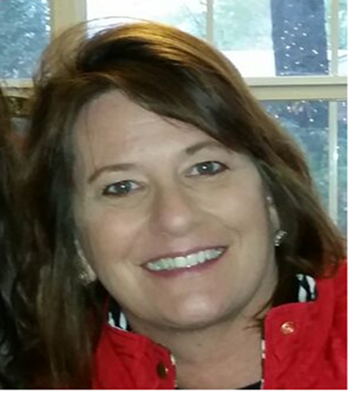
Anne Nyman
Education & Training
Finance
Hospitality & Tourism
850-245-9900
Anne.Nyman@fldoe.org

Slide 52
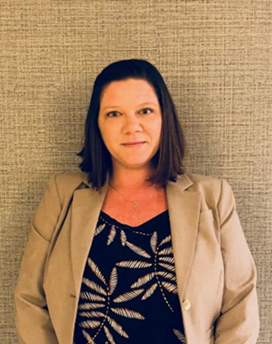
Melissa Tomlin
Law, Public Safety & Security
Arts, A/V Technology & Communication
850-245-0663
Melissa.Tomlin@fldoe.org

Slide 53
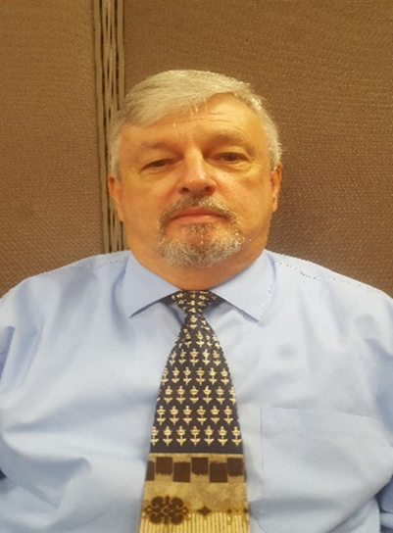
Robert “Bob” Blevins
Manufacturing
Transportation Distribution & Logistics
Engineering & Technology Education
850-245-9015
Robert.Blevins@fldoe.org

Slide 54
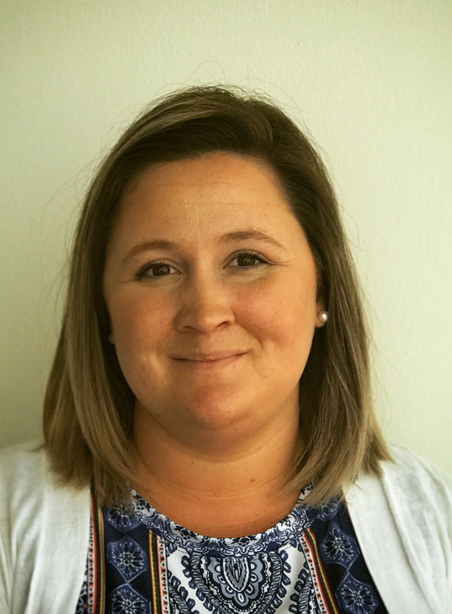
Kaitlin Vickers
Agriculture, Food, & Natural Resources
Government & Public Safety
Diversified Education
Other CTE Programs
850-245-9017
Kaitlin.Vickers@fldoe.org

Slide 55
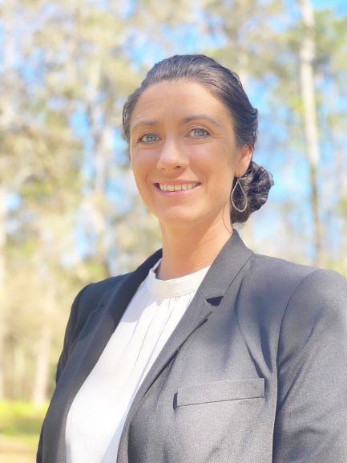
Elizabeth Winger
Information Technology
Business Management & Administration
850-245-9003
Elizabeth.Winger@fldoe.org

Slide 56
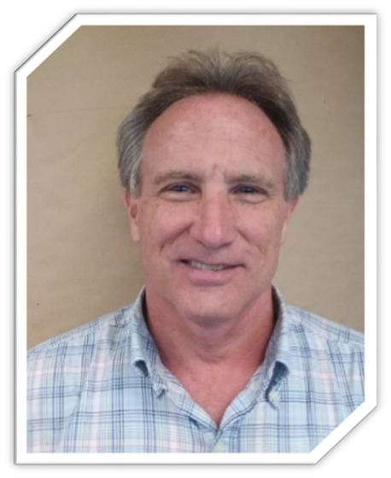
David Mueller
Marketing, Sales & Service
Architecture & Construction
Energy
850-245-9016
David.Mueller@fldoe.org

Slide 57
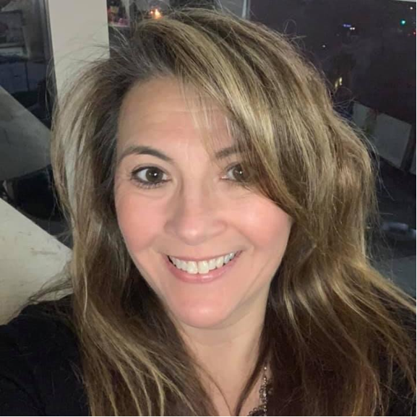
Pamela Gilman
Health Science
Human Services
850-245-9018
Pamela.Gilman@fldoe.org

Slide 58
Florida Career and Professional
Education Act (CAPE)
Kathryn Wheeler
CAPE Program Manager
Kathryn.wheeler@fldoe.org

Slide 59
What is CAPE?
The CAPE Act was created in 2007 to provide a statewide planning partnership between the business and education communities in order to attract, expand and retain targeted, high-value industry and to sustain a strong, knowledge-based economy.

Slide 60
The primary purpose of the CAPE Act is to:
Improve middle and high school academic performance by providing rigorous and relevant curriculum opportunities;
Provide rigorous and relevant career-themed courses that articulate to postsecondary-level coursework and lead to industry certification;
Support local and regional economic development;
Respond to Florida’s critical workforce needs; and
Provide state residents with access to high-wage and high-demand careers.

Slide 61
Benefits of CAPE for Students
Students earn industry certifications that make them more college- and career-ready.
Some industry certifications articulate for college credit.
College credit articulated may contribute to requirements for the Gold Seal CAPE (GSC) Scholarship.

Slide 62
Other Benefits of CAPE
Bonus FTE funding
Teacher bonuses
School grades

Slide 63
The making of the CAPE Industry Certification Funding List
Digital Tool Certificates
FDOE
Farm Occupations
Department of Agriculture and Consumer Services
Recommendations
CareerSource Florida
CAPE Industry Certification Funding
List

Slide 64
CareerSource Florida Request Cycle
CareerSource Florida (CSF) identifies potential credentials through open submission process.
Review by
CSF, DEO and DOE
CSF Board adopts recommended list of certifications.
Districts make requests from CSF recommended list of certifications.
DOE reviews requests, publishes and adopts ICFL and administrative rule for upcoming year.
August-September
April-August
September- December
March
February
For industry certifications for farm occupations, a separate process is used involving the Department of Agriculture and Consumer Services.

Slide 65
Self-Study Guide for Career Readiness in Secondary Schools
Dr. Kevin Smith
Regional Educational Laboratory (REL) Southeast
ksmith@fcrr.org

Slide 66
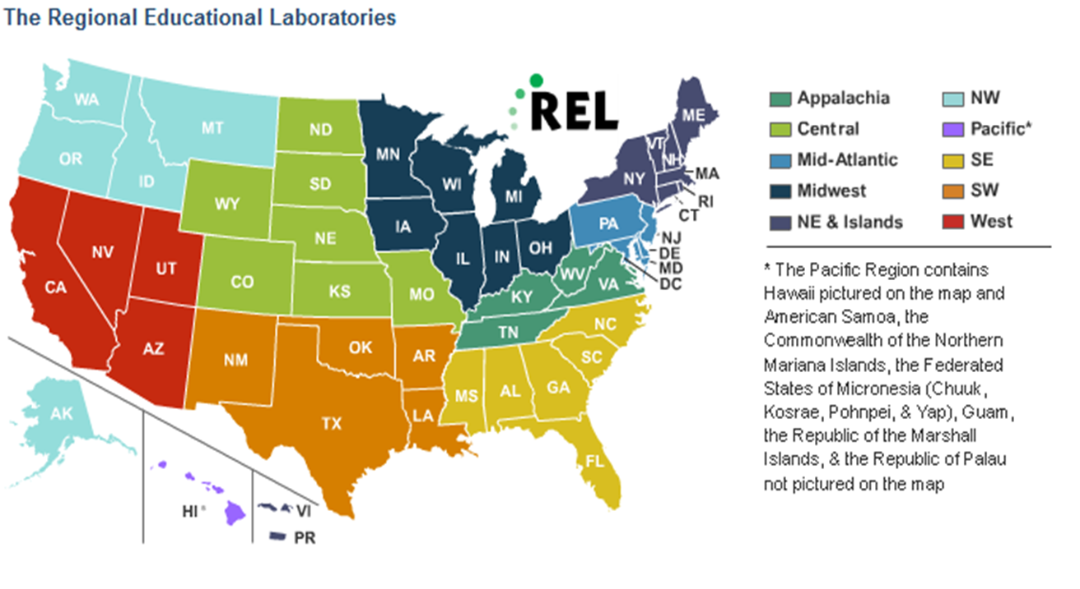
REL Southeast Overview

Slide 67
Introduction
The Self-Study Guide for Career Readiness in Secondary Schools was developed to help educators plan and implement district and school career readiness practices. It is intended to promote reflection about current strengths and challenges in planning for implementation of career readiness practices, spark conversations among staff and identify areas for improvement. The guide provides a template for data collection and guiding questions for discussion that may improve the implementation of career readiness practices and increase the number of students earning high school diplomas and successfully transitioning to postsecondary training and careers.

Slide 68
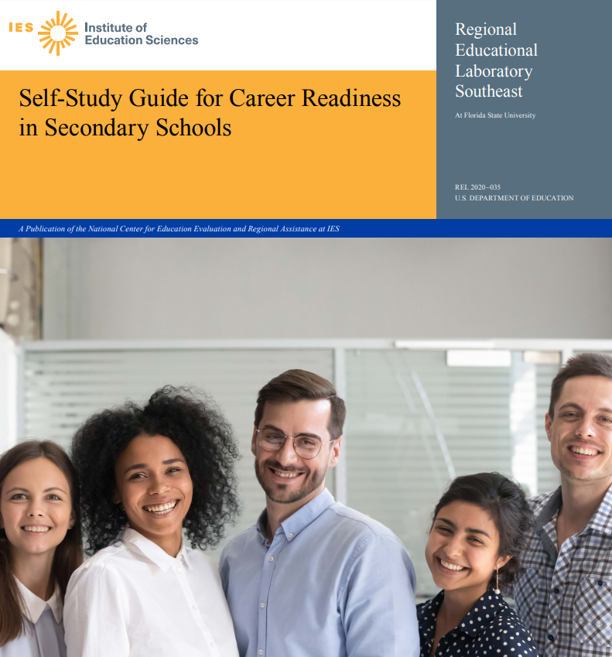
Career readiness elements for the self study-guide 1. Employability skills
2. Career exploration
3. Relevant course content
4. Individualized learning plans
5. Collaborative career counseling
6. Career counseling interventions
7. Career counseling interventions

Slide 69
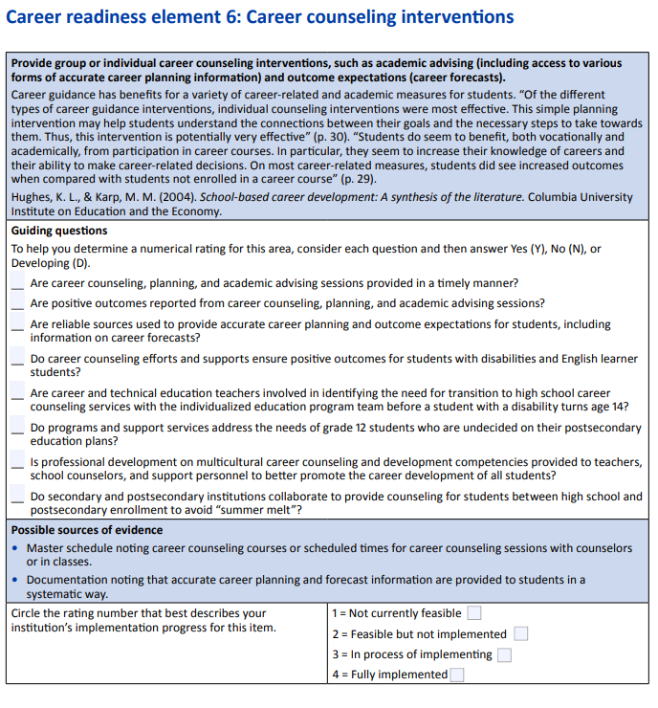
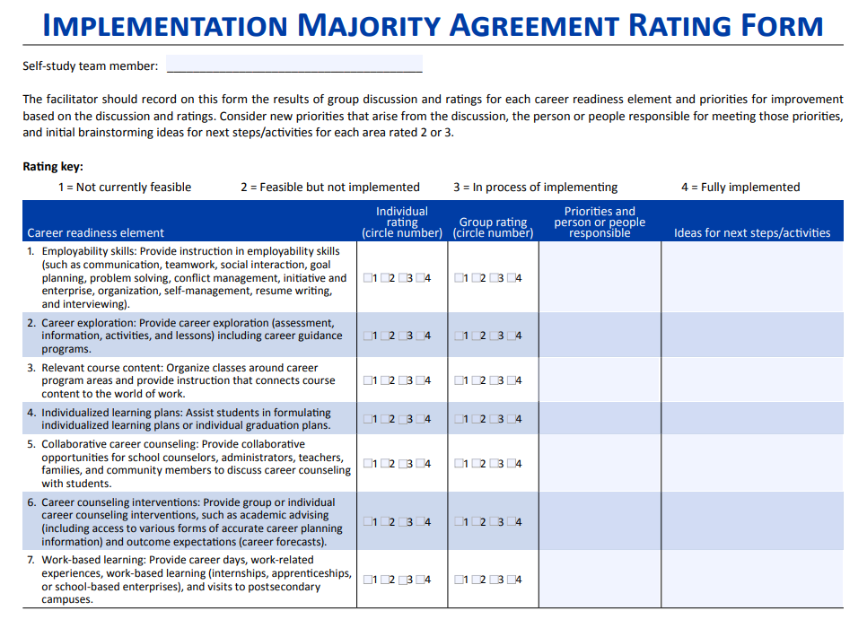

Slide 70
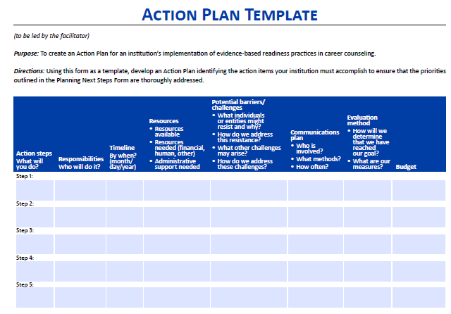

Slide 71
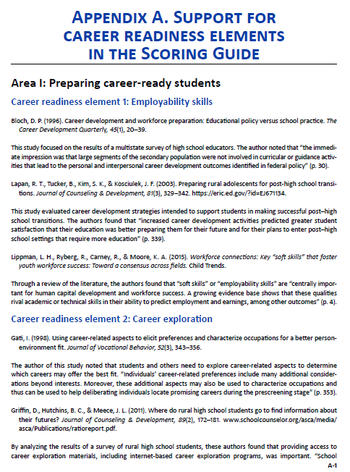

Slide 72
Individuals with Disabilities Act (IDEA) FAQ
Wendy Metty
Secondary Transition
Bureau of Exceptional Student Education
Wendy.Metty@fldoe.org

Slide 73
What legislation supports transition?
Both federal and state laws support transition
Based on section 300.43 of Title 34, Code of Federal Regulations (C.F.R.), which provides for a coordinated set of activities for a student with a disability that is designed within an outcome-oriented process, that promotes movement from school to post-school activities, including postsecondary education, vocational training, integrated employment, continuing and adult education, adult services, independent living or community participation,
and s. 1003.5716, F.S., which ensures quality planning for a successful transition of a student with a disability to postsecondary education and career opportunities, an IEP team shall begin the process of, and develop an IEP for, identifying the need for transition services before the student with a disability attains the age of 14 years in order for his or her postsecondary goals and career goals to be identified and in place when he or she attains the age of 16.

Slide 74
Should IEPs include a statement related to Pre-Employment Transition Services?
Yes, according to s. 1003.5716, F.S., which states:
All students with disabilities who are 3 years of age to 21 years of age have the right to a free, appropriate public education (FAPE). As used in this section, the term “IEP” means individual education plan.
(2) Beginning not later than the first IEP to be in effect when the student attains the age of 16, or younger if determined appropriate by the parent and the IEP team, the must include the following statements that must be updated annually: (c) A statement of appropriate measurable long-term postsecondary education and career goals based upon age-appropriate transition assessments related to training, education, employment, and, if appropriate, independent living skills and the transition services, including pre-employment transition services and courses of study needed to assist the student in reaching those goals.
Vocational Rehabilitation (VR) Pre-ETS Flyer

Slide 75
What additional graduation pathways are available to students with disabilities?
There are two additional graduation pathways only available to students with disabilities, both of which allow for CTE substitutions.
Standard Diploma via Academic and Employment Based Courses; and
Standard Diploma via Access Courses

Slide 76
What is deferral?
FAPE ends upon receipt of a standard diploma.
A deferral allows for a student with a disability, who meets the standard high school diploma requirements, to continue receiving FAPE if the student meets the requirements found at s. 1003.4282(10)(c), F.S.
Deferral of diploma allowed for those eligible
Process described in Rule 6A-1.09963, F.A.C.
Technical Assistance Paper (TAP): High School Graduation Options for Students With Disabilities
Notes:
(W)

Slide 77
Who determines deferral?
Deferral is an IEP team decision
Based on the individual transition needs of the student
Remember:
accelerated college credit,
industry certification,
a collegiate high school program,
courses to satisfy the Scholar designation, or
a structured work-study program
Notes:
Exceptionality should not determine whether student defers.

Slide 78
What is the district required to do in relation to deferral?
According to Rule 6A-1.09963(6), Florida Administrative Code (F.A.C.), which specifies the district’s obligations, include the following:
Review the benefits of deferring with the parent and the student, including continuation of educational and related services.
Describe to the parent and the student, in writing, all of the services and programs available to students who defer.
Note the deferral decision on the IEP.
Provide a document that notes the decision for the parent, or the student if over 18 and rights have transferred, to sign that is separate from the IEP.

Slide 79
What is the district required to do in relation to deferral?
Inform the parent and the student, in writing, by January 30 of the year in which the student is expected to meet all graduation requirements that failure to defer releases the school district of the obligation to provide FAPE, that the deadline for acceptance or deferral is May 15, and that failure to attend the graduation ceremony does NOT constitute deferral.
Ensure that the names of the students who are deferring are submitted to appropriate staff for entry into the district’s management information system.
Notes:
(W)

Slide 80
What happens when the student defers, but is not attending?
Based on s. 1003.4282(10)(c), F.S., there are two parts required for deferral:
1. The IEP requires special education, transition planning and services.
2. The student is enrolled in accelerated college credit, industry certification, a collegiate high school program, courses to satisfy the Scholar designation or a structured work-study program.
All efforts should be made to contact the student and parents and hold an IEP meeting to discuss.
After all efforts have been made, the district could propose to make a change in placement and issue the diploma.
Ending FAPE constitutes a change in placement, requiring prior written notice in accordance with 34 C.F.R. § 300.503.
Notes:
Based on the TAP, there are two parts required for deferral: 1. the IEP requires special education, transition planning and services and 2. The student is enrolled in accelerated college credit, industry certification, a collegiate high school program, courses to satisfy the Scholar designation or a structured work-study program.
If the student has never shown up or not attending, all efforts need to be made to reconvene the IEP team and discuss, as this should be an IEP team decision. If after all efforts have been made, the district could propose/take steps to make a change in placement and issue a diploma, as graduation from high school with a regular high school diploma constitutes a change in placement, requiring written prior notice in accordance with §300.503.
Be sure to complete due diligence prior to dismissing for non-attendance. Prior written notice with a reasonable time before the district must be provided. You may discuss with your district’s legal department.

Slide 81
Who is eligible for a waiver?
Section 1008.22(3)(c)(2), F.S., allows for a student with a disability, as defined in s. 1007.02, F.S., for whom the IEP team determines that the statewide, standardized assessments under this section cannot accurately measure the student’s abilities, taking into consideration all allowable accommodations, shall have assessment results waived for the purpose of receiving a course grade and a standard high school diploma.

Slide 82
What are the criteria for a waiver?
There are four criteria for a waiver. A waiver is for a student:
identified as a student with a disability,
with an IEP,
who has taken the statewide, standardized assessment with appropriate allowable accommodations at least once, and
for whom the IEP team determines that the statewide, standardized assessment cannot accurately measure the student’s abilities.
For additional information, please also see A-1 and A-2 from the TAP Waiver of Statewide, Standardized Assessment Results for Students with Disabilities.
Notes:
If an IEP team determines a waiver is appropriate for a student and then dismisses the student from services, it sounds as though the team is saying the student no longer has a disability and does not need services, so the student would not need a waiver. Sharing also , if the student is dismissed from services, it appears the criteria for 1 and 2 would no longer be appropriate. The student would need to pass or earn a concordant score. As these are IEP team decisions, It may be best for IEP teams considering dismissal to review all data, including waivers prior to dismissal or possibly consider moving to consultation and consider retakes or earning a concordant score.

Slide 83
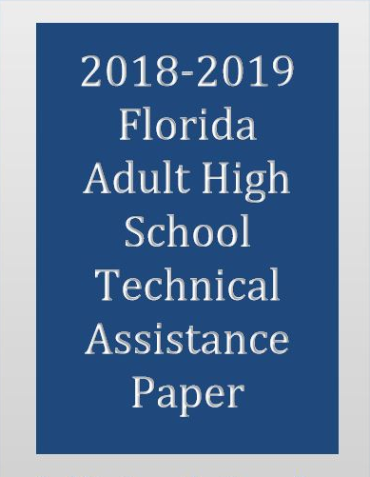
Does a waiver apply to students with disabilities in the adult high school programs?
Students with disabilities who have withdrawn from the K-12 system and possess a statewide, standardized assessment waiver may transfer this waiver to the Adult High School (AHS) program upon enrollment.
The extension of the waiver to the AHS program only applies to students who received waivers as part of s. 1008.22(6), F.S. Additional information can be found at Waiver of Statewide, Standardized Assessment Results for Students with Disabilities TAP.
Notes:
Statutory authority prohibits adult education programs from issuing waivers; however, for students without a waiver but self-identify as having a disability, every effort should be made by the program to provide accommodations and necessary support services to assist the students in meeting their goals to complete their high school diploma.

Slide 84
Helpful Resources

Slide 85
Where can I find transition information and resources?
Predictors of Post-School Outcomes
Transition Services Checklist
Secondary Transition Roadmap for Families
Middle School Transition Trail Map for Families
Benchmarks for Middle School Transition Planning
Resources and References for the Middle School Transition Trail Map
Getting Ready for Educational Opportunities After High School: Families Supporting Students for Success
Additional resources may be found at http://www.fldoe.org/academics/exceptional-student-edu/secondary-transition.stml and http://project10.info.

Slide 86
https://fl-pda.org
www.FLDOE.org

Slide 87
Florida Standards Alternate Assessment (FSAA) Eligibility Criteria
Chelsea Strickland, Program Specialist Chelsea.Strickland@fldoe.org
850-245-0475

Slide 88
ESSA – 1% Cap for Alternate Assessments
Notes:
Good morning! This is Chelsea Strickland, I am your Intellectual Disabilities Program Specialist. I am here with the Access Project. Thank you for being with us! Being part of this convening is special to me because I am from a small and rural district. My professional goal is to walk with districts to achieve excellence. Please notice , I said walk with, meaning beside you. If I walk in front you may run me over, and if I walk behind I might run you over. If we walk together we will get where we are going at the same time. Our perspectives will always be different, and that is okay. Next slide please.

Slide 89
How the 1% Cap is Calculated
Total Students with Disabilities Taking FSAA in Grades Tested
Divided by
Total Students in Grades Tested
Notes:
The Elementary and Secondary Education Act, as amended by the Every Student Succeeds Act or ESSA, in 2015, mandates that only students with the most significant cognitive disabilities participate in an alternate assessment based on alternate academic achievement standards (AA-AAAS) and that this group of students must not exceed 1% of the total number of students assessed.
As presented in this slide, the percentage of students taking the Alternate Assessment or the Florida Standards Alternate Assessment FSAA in Florida, is calculated by diving the number of students who participated in the FSAA, by the number of students who participated in the FSA and FSAA. Next slide, please.

Slide 90
1% Cap
Notes:
ESSA language that gives SEAs the authority to request justification from LEAs who exceed the 1% Cap
While there is a limit on the percentage of students statewide who may take an alternate assessment, there is no such limit on local educational agencies (LEAs). However, LEAs exceeding the cap applied to the State shall submit information to the State educational agency justifying the need to assess more than 1% of its students in any subject with an alternate assessment. Florida’s training and focus will continue to be on ensuring that individual educational plan (IEP) teams make the appropriate, individualized and data-based decision for each student. Next slide, please!

Slide 91
Alternate Assessment and the 1% Cap
Memo sent to all districts July 2017 explaining that Florida has surpassed the 1% state level and monitoring would occur for appropriate participation in alternate assessment based on alternate academic achievement standards (AA-AAAS).
Florida tested 1.5% in ELA and 1.6% in Math and Science during the 2019 administration of FSAA.
Exceeding the 1% threshold may result in Title I funds being withheld.
Florida was granted a waiver to assess more than 1% for the 2019-2020 school year, and an extension was granted for the 2020-2021 school year.
Notes:
In July of 2017, the USDOE sent a memo that explained the 1% cap is at the state level, and that appropriate participation in alternate assessments would be monitored.
Florida assessed 1.5% of students in ELA, 1.6% in Math and 1.6% in Science during the 2019 administration of the FSAA. As of the 2020-2021 Survey 2 data (that is October 2020 FTE) the percentage of students enrolled in access courses requiring a FSAA in science was 1.6%, a FSAA in math was 1.6%, and an FSAA in ELA was 1.5%.
Yes, the majority of Florida’s districts have exceeded 1% in at least one of the three content areas. States that continue to exceed the 1% threshold may have Title 1 funds withheld. Next slide please!

Slide 92
Reminders about Access Courses:
Rule 6A-1.0943(5), F.A.C., states that only students determined to have the most significant cognitive disability may be enrolled in access courses.
Rule 6A-6.03018, F.A.C., states students determined to have a specific learning disability have been determined not to have the most significant cognitive disability and must not be enrolled in access courses.
Students correctly enrolled in access courses must take the FSAA.
Notes:
Here are some reminders. Access Courses are only for those students with the most significant cognitive disabilities. If it has been determined that a student has a specific learning disability or SLD then, according to the rule you see listed, it has also been determined that the student does not have a significant cognitive disability. Of course, students correctly enrolled in access courses must take the FSAA, if applicable. Next slide please.

Slide 93
The Role and Function of a School Psychologist
Q: What is the role and function of a school psychologist when helping determine if a significant cognitive disability exists that warrants modifications in content standards and instruction on Access Points?
6A-6.03011 (1) & (4), F.A.C.
2012 Guidance Document: Significant Cognitive Disabilities
2017 TAP DPS: 2014-208 (C-1, C-2)
A: The school psychologist plays a vital role and has an essential function in determining the need for instruction on Access Points.
Notes:
The psychologist is the only member of the IEP team qualified to interpret a psycho-educational evaluation.

Slide 94
Rule 6A-6.03011, F.A.C.
(1) Definition -
An intellectual disability is defined as significantly below average general intellectual and adaptive functioning manifested during the developmental period, with significant delays in academic skills. Developmental period refers to birth to 18 years of age.
(4) Criteria for eligibility - Four data elements to analyze
Intellectual functioning
Adaptive functioning
Academic or pre-academic performance
Social/developmental history
Notes:
I want to point out that not all of the exceptionalities that are indicative of a most significant cognitive disability, which are a(i.e., intellectual disability, autism spectrum disorder, traumatic brain injury, and other health impairment) require the same data elements as an intellectual disability. An intellectual disability requires those four seen here: intellectual functioning, adaptive functioning, academic or pre-academic performance, and social/ developmental history.

Slide 95
Significant Cognitive Disabilities
Reliance on intelligence quotient (IQ) scores alone is not sufficient. Therefore, IEP teams should review available student information for evidence of a significant cognitive disability.

Slide 96
Significant Cognitive Disabilities
IEP teams should review available student information for evidence of a significant cognitive disability. Such information includes the following:
psychological assessments achievement test data
previous statewide assessment and district-wide test scores
aptitude tests
observations
attendance records
medical records
mental health assessments
adaptive behavior assessments
language assessments
curricular content
school history
student response to instructional intervention

Slide 97
IEP Team Membership
When determining if a student has a significant cognitive disability in need of modified standards and Access Points instruction, districts must ensure that the right people, at the right time, are present in every IEP meeting to increase the chances of the right decision being made.
The Right People = The qualified members needed to address every data element being analyzed
The Right Time = Anytime specialized instruction is being considered (e.g., Initial Meeting, Triennial Meeting, Interim Meeting)
Notes:
The IEP team membership is critical. First, please remember that the parent is a member of the IEP team. The other members are those who interact with the student and are qualifies to interpret the data being presented and discussed.
The Code of Federal Regulations (C.F.R.) 300.321 section (5) states: An individual who can interpret the instructional implications of evaluation results.
I will be honest with you, I have reviewed hundreds of IEPs, and read many psycho-educational evaluations, language evaluations, speech screeners, occupational therapy reports, and physical therapy reports, and though I understand them, I am not qualified to interpret them. Understanding and interpreting are two very different verbs, and they are not to be confused.
So, if psycho-evaluation data is being discussed, the psychologist MUST be present to interpret those result, because the school psychologist is the only IEP team member qualified to do so.
If classroom data is being reviewed, or standards access points progress monitoring is being reviewed , the teacher is the qualified team member. If language data is being review, the SLP is the only qualified team member.

Slide 98
Eligibility Criteria for Instruction in Florida Standards Access Points and Participation in the FSAA:
Reminder
Questions to Guide the Decision-Making Process
Does the student have one of the most significant cognitive disabilities?
Even with appropriate and allowable instructional accommodations, assistive technology, or accessible instructional materials, does the student require modifications, as defined in Rule 6A-6.03411(1)(z), F.A.C., to the grade-level general state content standards pursuant to Rule 6A-1.09401, F.A.C.?
Does the student require direct instruction in academic areas of English language arts (ELA), mathematics, social studies and science based on Access Points in order to acquire, generalize and transfer skills across settings?
Assessment Planning Resource Guide For Individual Educational Planning
https://fsaa-training.onlinehelp.measuredprogress.org/wp-content/uploads/sites/8/docs/FlaAlt_ResourceGuideIEP.pdf
Notes:
Here is the eligibility criteria for instruction in Florida Standards Access Points, IN ANY GRADE. These questions MUST be asked at every IEP meeting when instruction in access points and, if applicable participation in FSAA are being considered, reviewed, or revised. The Assessment Planning Resource Guide for IEP teams is located on the FSAA portal; we have included the hyperlink there for your convenience.
As you see number one says that the student must have a most significant cognitive disability, number two even with appropriate and allowable instructional accommodations, assistive technology, or accessible instructional materials, does the student require modifications, as defined in this rule, to the grade-level general state content standards? So, have accommodations been tried with integrity and data has been kept. Remember, ALL means ALL and every student should be working in MTSS. Just because a student has been staffed and has an IEP, does not mean MTSS stops! Number three the student requires direct instruction in all academic areas. Next slide please.

Slide 99
Rule 6A-1.09430, F.A.C., Rule Revision
Purpose of this rule revision:
Specify exclusionary and inclusionary criteria of a student who is eligible to participate in the administration of the statewide, standardized alternate assessment.
Establish a clear definition for most significant cognitive disability.

Slide 100
Instruction in Florida Standards Access Points, FSAA and Parent Consent
In accordance with Rule 6A-6.0331(10)(b), F.A.C., if the decision of the IEP team is that the student will participate in Access Courses and, if applicable, be assessed through the FSAA, the parents of the student must give signed consent to have their child instructed in Florida Standards Access Points and the student’s achievement measured based on alternate academic achievement standards.
This decision must be documented on the Parental Consent Form—Instruction in the State Standards Access Points Curriculum and FSAA administration, available at http://www.fldoe.org/academics/exceptional-student-edu/beess-resources/parental-consent-form-prior-written-no.stml.
Notes:
If the decision of the IEP team is that the student will participate in Access Courses and, if applicable, be assessed through the FSAA, the parents of the student must give signed consent to have their child instructed in Florida Standards Access Points and the student’s achievement measured based on alternate academic achievement standards . The Parental Consent Form—Instruction in the State Standards Access Points Curriculum and FSAA Administration, is how this decision must be documented, we have included the link for your convenience. Next slide please.

Slide 101
FSAA and Parent Consent
If the parents fail to respond after reasonable efforts by the school district to obtain consent, the school district may provide instruction in the state standards Access Points curriculum and administer the FSAA.
The IEP should include a statement of why the student cannot participate in the general assessment and why the alternate assessment is appropriate.
Notes:
If the parents fail to respond after reasonable efforts by the school district to obtain consent, the school district may provide instruction in the state standards Access Points curriculum and administer the FSAA. It may be helpful to give an IEP team member the task of obtaining these signatures, like a staffing specialist. Document, document document! Especially now! And, IEPs should include a statement of why the student cannot participate in the general assessment and why the alternate assessment is appropriate. Reasonable effort is beyond phone calls. Certified mail, and home visits are reasonable efforts. If there is no responds due process must be initiated. Next slide please.

Slide 102
1% Waiver and Percent Tested
States must test 95% of students for each subject area in order to apply for a waiver of the federal impact of exceeding the 1% cap (this impacts Title I funding).
Schools testing less than 95% of their students, overall or by subgroup, will have to review their testing practices and submit a plan for change to achieve 95% tested.
Florida has applied for the 95% participation waiver for the 2020-2021 school year.
Notes:
States must test at least 95 % of students for each subject area in order to apply for a waiver of the federal impact of exceeding the 1% cap. As mentioned earlier, THIS IMPACTS TITLE FUNDING.
Districts and schools testing less than 95% of their students, overall or by subgroup, will have to review their testing practices and submit a plan for achieving 95%. Next slide please.

Slide 103
Office of Articulation
Trinity Henderson
850-245-9543
Trinity.Henderson@fldoe.org
Amanda Walker
850-245-9549
Amanda.Walker@fldoe.org

Slide 104
Articulation Topics
Credit Acceleration Program
Transcript Reporting and Reminders
Bright Futures and Talented Twenty
FAS/FMS/GSV Scholarship Program Requirements
Bright Futures Program Resources
Talented Twenty Program and Course Requirements
Bright Futures Course Table and Data Fields
Credit-by-Examination
Dual Enrollment
Presenter Contact Information

Slide 105
Credit Acceleration Program (CAP)
Authorized by s. 1003.4295, F.S.
A student may earn high school credit in Algebra 1, Geometry, U.S. History or Biology 1 if the student passes the corresponding statewide, standardized end-of-course (EOC) assessment without the requirement of enrolling in or completing the course.
A student can earn high school credit in courses required for high school graduation through the passage of an Advanced Placement (AP) examination or a College Level Examination Program (CLEP). If a student attains a passing score on an AP examination or CLEP, then the school district is required to award course credit to the student who is not enrolled in or who has not completed the course.

Slide 106
CAP Transcript Reporting
What is recorded on the high school transcript if a student earns course credit without enrollment in a course?
An entry is listed with the course name, number, credit attempted, credit earned and a grade of “T” in the term that the assessment or examination is passed.
What is recorded on the high school transcript if a student took and passed an EOC assessment or AP examination with enrollment in the respective course for one semester?
The grade for the term the student was enrolled is recorded on the high school transcript and counts in the cumulative grade point average (GPA). An additional course entry is listed with the course name, number, credit attempted, credit earned and a grade of “T.”
The CLEP course numbers and subject codes are listed in the Course Code Directory (CCD).

Slide 107
CAP Reminders
Comparative scores cannot be used to earn Algebra 1 credit via the CAP.
Middle grades students may earn high school course credit through the CAP if the student passes the statewide EOC without enrolling in or completing the course.
Schools may not require a dual enrollment student to take a high school course as preparation before taking an EOC. Credit can be awarded toward high school graduation requirements using the CAP.

Slide 108
Bright Futures and Talented Twenty
State Scholarship Programs (ss. 1009.53–1009.538, F.S.)
Florida Academic Scholar
Florida Medallion Scholar
Gold Seal Vocational
State University System (SUS) Admissions (Board of Governor Regulation 6.002)
Talented Twenty

Slide 109
Bright Futures Scholarship Program Requirements (FAS/FMS)
FAS and FMS initial eligibility requirements:
Graduate high school from a Florida public high school with a standard Florida high school diploma (high school graduation requirements), graduate from a registered FDOE private high school, earn a GED, complete a home education program or graduate from a non-Florida high school;
Complete the required high school coursework;
Achieve the required minimum high school GPA;
Achieve the required minimum score on either the ACT® or SAT® college entrance exam; and
Complete the required number of service hours.
TYPE | 16 High School Course Credits | High School Weighted Bright Futures GPA | College Entrance Exams by High School Graduation Year (ACT®/SAT®) | Service Hours
FAS | 4 - English (three must include substantial writing) 4 - Mathematics (at or above the Algebra 1 level) 3 - Natural Science (two must have substantial laboratory) 3 - Social Science 2 - World Language (sequential, in same language) | 3.50 | 2020-21 Graduates: 29/1330 2021-22 Graduates: 29/1330 | 100 hours
FMS |  | 3.00 | 2020-21 Graduates: 25/1210 2021-22 Graduates: 25/1210 | 75 hours

Slide 110
Bright Futures Scholarship Program Requirements (GSV)
Florida GSV initial eligibility requirements:
Achieve the required weighted minimum 3.0 GPA in the non-elective high school courses;
Take at least three full credits in a single CTE program;
Achieve the required minimum 3.5 unweighted GPA in the career education courses;
Achieve the required minimum score on the ACT®, SAT® or Florida Postsecondary Education Readiness Test (P.E.R.T.) exams (see table below); and
Complete 30 service hours.
Exam Type | Sub-Test | Required Score
ACT® | Reading | 19
 | English | 17
 | Mathematics | 10
SAT® | Reading Test | 24
 | Writing and Language Test | 25
 | Math Test | 24
P.E.R.T. (only applies to the GSV Scholarship) | Reading | 106
 | Writing | 103
 | Mathematics | 114

Slide 111
Bright Futures Scholarship Program Resources
The Bright Futures Scholarship Program Student Handbook provides additional ways to qualify.
Refer to the Bright Futures Course Table (BFCT) for specific information on which courses count toward Bright Futures Scholarship requirements.
The BFCT is also used to determine which courses count toward the Talented Twenty Program.

Slide 112
Talented Twenty Program Requirements
Within space and fiscal limitations, admission to a university in the SUS shall be granted to a first-time-in-college (FTIC) applicant who:
is a graduate of a public Florida high school;
has completed the eighteen (18) required high school units;
ranks in the top 20% of his/her high school graduating class; and
has submitted SAT scores or ACT scores, prior to enrollment.
A Talented Twenty student is not guaranteed admission to the university of first choice and should work closely with a high school counselor to identify options. The SUS will use class rank as determined by the FDOE.

Slide 113
Talented Twenty Course Requirements
Students Entering High School July 1, 2007, or Later*
4 credits – English/Language Arts (three of which must have included substantial writing requirements).
4 credits – Mathematics (at or above the Algebra 1 level).
3 credits – Natural Science (two of which must have included substantial laboratory requirements).
3 credits – Social Science (to include anthropology, history, civics, political science, economics, sociology, psychology and/or geography).
2 credits – Foreign Language See subsection (1)(h) of BOG Regulation 6.002.
2 credits – Additional academic credits (in any combination of courses listed in the FDOE CCD). Two credits from among Level 2 courses listed in the CCD in English/Language Arts, Mathematics, Natural Science, Social Science, World Language, Performing/Fine Arts; Level 3 courses listed in the CCD in any academic or career and technical education credited discipline; or Dual Enrollment courses for which both high school and postsecondary academic credits are granted; OR One credit from 1. above and one credit from grade nine or above in JROTC/Military Training, or an equivalent course in any discipline as determined by the Articulation Coordinating Committee.
*Students entering high school before July 1, 2007, are required to have the credits listed above; however, they are only required to take three credits in the required mathematics. This adjustment then allows for three additional credits (instead of two), including Level 3 courses in any discipline.

Slide 114
Bright Futures Course Table
The BFCT provides post-graduation information critical to determining whether a student meets the qualifications of the Bright Futures Scholarship Programs and Talented Twenty based on courses taken during their secondary education.
Comprised of course data from the CCD and Statewide Course Numbering System (SCNS)
K-12, Career/Technical and Adult Education Courses (CCD)
Advanced Placement, AICE, IB and CLEP
Dual Enrollment (SCNS)
Academic
Career
Not intended as a resource to determine progress toward completion of Florida’s graduation requirements.

Slide 115
BFCT Data Fields Explained
Course Number | Course Title | K-12 Subj Area | Max Credits | Effective HS Years | Wghtd | FAS/FMS | Lang Req Met | GSV | Voc Prog | SUS Subj Area | SUS Admission
1001310 | ENG 1 | EN | 1 | 1990-91 — 2099 | N | C | N/A | C | N | EN | C
8006120 | INTRO TO ALT ENERGY | EQ | 1 | 2014-15 — 2099 | Y | N | N/A | C | Y | EL | E
8600580 | AEROSPACE TECH 1 | EQ | 1 | 2014-15 — 2099 | Y | N | N/A | C | Y | EL | N
ASL1110 | AM SIGN LANGUAGE I | FL | 0.5 | 2010-11 — 2099 | Y | C | N | E | N | FL | C
The CCD and SCNS provide the following data to populate the BFCT:
Course Number
Course Title
K-12 Subject Area (this is a subject area code, NOT a graduation code)
Max Credits
Effective HS Years (beginning and ending school year; 2099 indicates valid for future years)
Weighted (N=Level 2 course, Y=Level 3 course)
Voc Program (N=course not included in a Career/Technical program, Y=course included in a Career/Technical program)

Slide 116
BFCT Data Fields Explained, continued
Course Number | Course Title | K-12 Subj Area | Max Credits | Effective HS Years | Wghtd | FAS/FMS | Lang Req Met | GSV | Voc Prog | SUS Subj Area | SUS Admission
1001310 | ENG 1 | EN | 1 | 1990-91 — 2099 | N | C | N/A | C | N | EN | C
8006120 | INTRO TO ALT ENERGY | EQ | 1 | 2014-15 — 2099 | Y | N | N/A | C | Y | EL | E
8600580 | AEROSPACE TECH 1 | EQ | 1 | 2014-15 — 2099 | Y | N | N/A | C | Y | EL | N
ASL1110 | AM SIGN LANGUAGE I | FL | 0.5 | 2010-11 — 2099 | Y | C | N | E | N | FL | C
The following fields on the BFCT are determined by the specific requirements for FAS/FMS, GSV and Talented Twenty.
FAS/FMS (must count as Core for SUS admissions, based on SUS faculty review)
GSV (must count toward a specific high school graduation requirement, as listed in the CCD for the year the student took the course)
Lang Req Met (determined by SUS faculty review; N=does not meet SUS requirement, Y=meets SUS requirement for foreign language proficiency to the 2nd high school level or higher)
SUS Subj Area (determined by SUS admissions requirements)
SUS Admission (determined by SUS faculty review of curriculum)

Slide 117
Credit-by-Examination
High School students are able to take multiple exams that will award them college credit.
CLEP
AP
IB
AICE
When participating in dual enrollment and credit by exam, students and advisors should monitor both closely to ensure that students are not duplicating college credit.
For example, if a student takes AP English Literature and scores at least a 3, he/she will receive credit for ENCX101. Therefore, he/she should also not dual enroll in ENCX101.

Slide 118
Dual Enrollment
Section 1007.271, F.S., states “each district school superintendent and Florida College System institution president shall develop a comprehensive dual enrollment articulation for the respective school district and Florida College System institution.”
Districts must have agreements with the area Florida College System Institution and District Sponsored Career and Technical Center.
Additional agreement options:
Career Centers
State Universities
Eligible private colleges and universities

Slide 119
Advising
Dual enrollment is an acceleration program that allows high school students, including home education students and students with disabilities, to take postsecondary coursework and simultaneously earn high school credit toward a high school diploma, a career certificate, an industry certification, or an associate or baccalaureate degree.
School counselors and college advisors should work together.
Students should be encouraged to enroll in courses that meet:
High school core and college General Education Core requirements.
High school core and college general education or major prerequisites.
High school elective and college general education or major requirements.
High school and college electives.

Slide 120
Resources
Dual Enrollment Course-High School Subject Equivalency List:
Academic Courses: http://www.fldoe.org/core/fileparse.php/5421/urlt/AcademicList.pdf
Career and Technical Courses: http://www.fldoe.org/core/fileparse.php/5421/urlt/CareerTechList.pdf
ACC Credit-by-Examination List:
RECOMMENDATIONS TO THE ARTICULATION COORDINATING COMMITTEE FOR CREDIT-BY-EXAM EQUIVALENTS (fldoe.org)
Postsecondary General Education Core:
http://www.fldoe.org/policy/articulation/general-edu-core-course-options.stml
Postsecondary Common Prerequisite Manuals:
https://dlss.flvc.org/admin-tools/common-prerequisites-manuals
Dual Enrollment Articulation Agreements:
http://www.fldoe.org/policy/articulation/dual-enrollment-agreements.stml

Slide 121
Florida Bright Futures Scholarship Program Initial Eligibility
Email: osfa@fldoe.org
Telephone: 1-888-827-2004
OSFA Director Outreach Services:
Pete Hernandez | 850.245.1821 Pedro.Hernandez@fldoe.org

Slide 122
Topics
Bright Futures:
Home Screen
Initial Eligibility Requirements
OSFA-STATE HS#20-21:03 Memorandum
Evaluation Process and Award Notifications

Slide 123
Bright Futures Home Screen

Slide 124
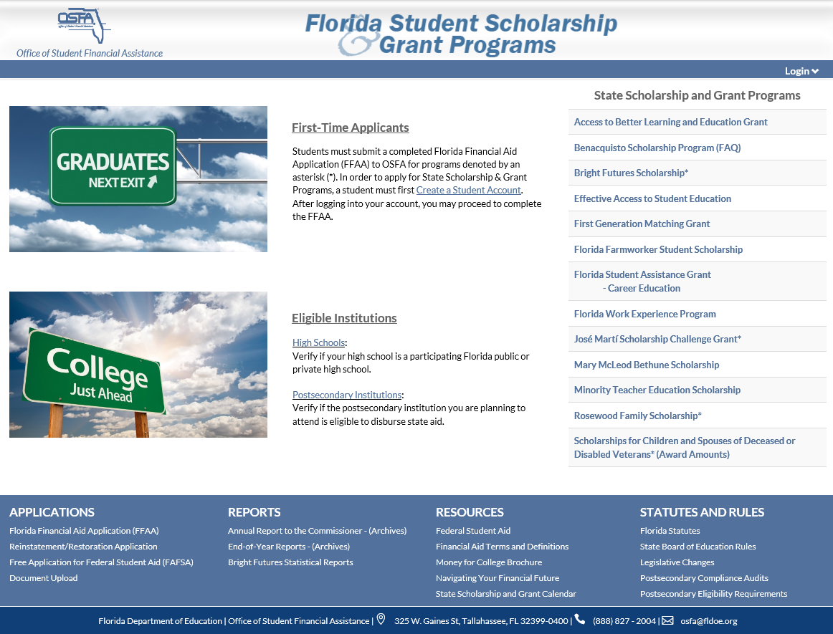
State Scholarship and Grant Programs

Slide 125
Florida Bright Futures Scholarship Program
Notes:
***PENDING UPDATE***

Slide 126
Bright Futures Initial Eligibility Requirements

Slide 127
General Requirements
Be a Florida resident and a U.S. citizen or eligible noncitizen, as determined by the student’s postsecondary institution.
Complete the Florida Financial Aid Application (FFAA) during senior year of high school beginning October 1, but no later than August 31 after high school graduation.
Earn a standard Florida high school diploma, or its equivalent, from a Florida public high school or a registered private high school.

Slide 128
General Requirements, continued
Not have been found guilty of, or pled nolo contendere to, a felony charge.
Be accepted by and enroll as a degree- or certificate-seeking student at an eligible Florida public or independent postsecondary institution within five years of high school graduation.
Enroll in at least six non-remedial semester hours (or the equivalent in quarter or clock hours) per term.

Slide 129
Bright Futures Scholarship Program Awards
Students may receive funding for ONE of the award levels:
FAS Award
FMS Award
Florida Gold Seal CAPE (GSC) Scholars
Florida Gold Seal Vocational (GSV) Scholars

Slide 130
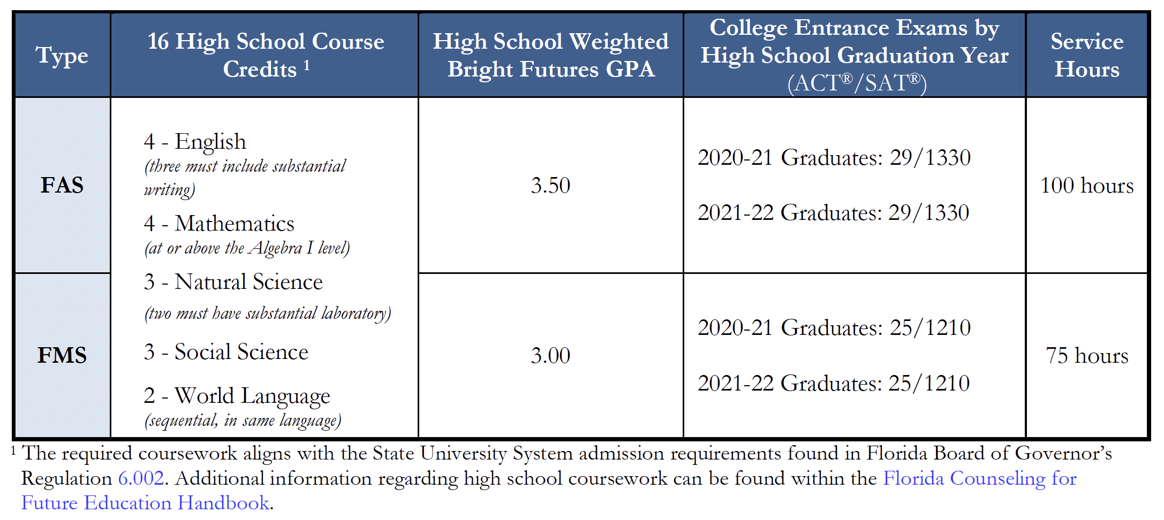
FAS and FMS Award Requirements

Slide 131
Student Report Cards
Section 1009.531(4), F.S.
Public high school student report cards for 11 and 12 grades must contain a disclosure that the GPA calculated for purposes of the Florida Bright Futures Scholarship Program may differ from the GPA on the report card.
A+

Slide 132
Grade Point Average
Evaluation for Bright Futures includes an unrounded, weighted high school GPA (calculated to two decimal places) in the 16 college-preparatory credits.
The following courses are weighted .25 per semester course or .50 per year course in calculation of the GPA:
Honors
Dual Enrollment
AP
Pre-IB
IB
Pre-AICE
AICE

Slide 133
College Entrance Exams (ACT/SAT)
Students must meet the requirements outlined in statute for either the SAT or ACT.
Per s. 1009.531(6)(c), F.S., the department shall develop a method for determining the required examination scores which incorporates all of the following:
FAS scholars – 89th national percentile
FMS scholars – 75th national percentile
Scores must be concordant between ACT and SAT
Publish scores for the rising junior class each year

Slide 134
College Entrance Exams (ACT/SAT)
Tests taken through June 30 of high school graduation year are accepted for evaluation purposes.
Students will be evaluated based on official test scores from the FDOE repository. To ensure OSFA obtains official test scores:
Ensure demographics on test registration and high school transcript match; and
Request official test scores be sent to one of Florida’s state universities, when registering for the ACT/SAT, even if the student plans to attend an institution that is not a state university.

Slide 135
Service Hours
Each district school board and the administration of a nonpublic school must establish approved activities, the process for documentation of service hours and the established deadline to complete and turn in service hours.
Total service hours completed must be reflected on student transcript submission to OSFA.

Slide 136
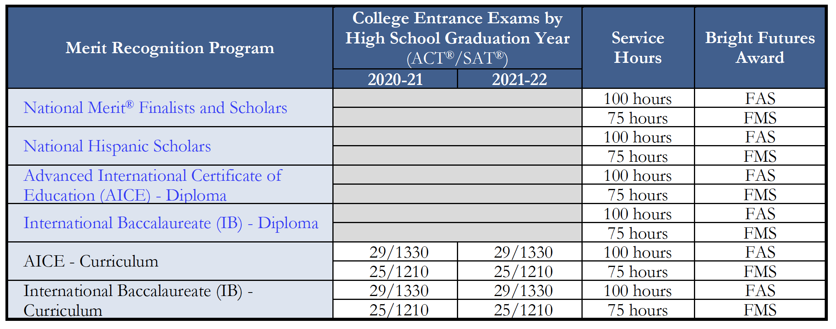
Other Ways to Qualify
Students who have demonstrated academic merit through a recognition program may be eligible for Bright Futures without having to meet one or more of the requirements.
Note: Both AICE and IB Diplomas must be earned prior to high school graduation.

Slide 137
GSC Scholars Award Requirements
Florida high school students who wish to qualify for the Florida GSC award must meet the following initial eligibility requirements:
Earn a minimum of 5 postsecondary credit hours through CAPE industry certifications, which articulate for college credit.
Complete and turn in 30 service hours.

Slide 138
GSC Scholars
GSC may be funded if enrolled in a career education or certificate program.
Upon completion of an associate in science degree program that articulates to a bachelor of science degree, a GSC Scholar may also receive an award for a maximum of 60 credit hours toward a bachelor of science degree program.
Upon completion of an associate in applied science program, a GSC Scholar may also receive an award for a maximum of 60 credit hours toward a bachelor of applied science degree program.

Slide 139
GSV Scholars Award Requirements
Achieve the required weighted minimum 3.0 GPA in the non-elective high school courses.
Take at least 3 full credits in a single CTE program.
Achieve the required minimum 3.5 unweighted GPA in the career education courses.
Achieve the required minimum score on the ACT®, SAT® or Florida P.E.R.T. exams.
Complete 30 service hours.

Slide 140
GSV Award Requirements, continued
Required minimum score table:
Required test scores follow those established by State Board of Education Rule 6A-100315, F.A.C.

Slide 141
GSV
GSV Scholars awards may only be used at postsecondary institutions that offer:
Applied Technology Diploma
Technical Degree Education Program (associate in applied science or associate in science)
Career Education Certificate Program

Slide 142
Bright Futures Evaluation Process and Award Notification

Slide 143
Evaluation Periods
There are two evaluation periods:
Early Evaluation
Final Evaluation
Transcripts should be submitted within 30 days of the end of each semester.

Slide 144
Early Evaluation
Students cannot lose an award based on early evaluation unless they fail to earn a standard Florida high school diploma from a Florida public or FDOE-registered private high school.
Early Evaluation is based on:
Required coursework and GPA through 7th semester
Coursework in progress for 8th semester
Service hours earned through January 31
Test scores for tests taken through January 31

Slide 145
Final Evaluation
Final Evaluation is based on:
All required coursework and GPA completed by high school graduation
Service hours completed by high school graduation or a date established by the public school district/nonpublic school administrators
Test scores for all tests taken through June 30 of high school graduation year
High school graduation date associated with earning a standard high school diploma

Slide 146
Eligibility Notifications
Upon creation of a Student Account, students will receive a User Name and Password.
Students must check their online account for award notices – students are responsible for keeping their demographic information updated and tracking their application and award status.
OSFA will post official award eligibility or ineligibility determinations to student online accounts.
Students awarded IB or AICE Diplomas will receive notifications of eligibility determination in early fall after a list of IB and AICE Diploma recipients has been received. These students must have filled out a FFAA prior to August 31 to receive the award.

Slide 147
Award Amounts
FAS scholars attending a public institution will receive an award to cover 100% of tuition and applicable fees and $300 for both fall and spring semesters for additional expenses.
FMS scholars attending a public institution will receive an award to cover 75% of tuition and applicable fees.

Slide 148
Award Amounts, continued
FAS and FMS students attending a nonpublic institution will receive a comparable amount as noted in the Private Award Chart accessible through the Bright Futures Student Handbook, Chapter 2, page 4. https://www.FloridaStudentFinancialAidsg.org/PDF/BFHandbookChapter2.pdf
For the GSC and GSV awards, students will receive the specified award amounts established annually by the Florida Legislature in the General Appropriations Act.
For current year award amounts, visit https://www.FloridaStudentFinancialAidsg.org/SAPBFMAIN/SAPBFMAIN.

Slide 149
Application Dates
The FFAA for current high school seniors is open from October 1, 2020 through August 31, 2021.
Students must complete the FFAA no later than August 31 after graduation for Bright Futures.
Students must complete the FFAA no later than April 1 before graduation for:
José Martí Scholarship Challenge Grant (JM)
Rosewood Family Scholarship (RFS)
Scholarships for Children and Spouses of Deceased of Disabled Veterans (CSDDV)*
Florida Farmworker Student Scholarship (FFSS)
*CSDDV applications will be accepted after April 1; however, may not receive priority funding due to being late.

Slide 150
Medicaid Certified School Match (MCSM) Program
Nanci English, Medicaid Consultant
850-245-5075
Nanci.English@fldoe.org
Medicaid In Schools

Slide 151
MCSM Program
The purpose of the MCSM program is to provide reimbursement for medically necessary services provided by schools or school district employees or contractors by a school district or schools to Medicaid-eligible students.​

Slide 152
Students Qualified for Certified Match
Medicaid-eligible on date of service​
Under the age of 21​
Medicaid reimbursable services recommended by school district employees/contracted staff​

Slide 153
CS/HB 81 – Health Care for Children
Amended s. 409.9071, F.S.
Removed language that certified match is only available for services on the student’s IEP or IFSP
Applies only to school districts
Not charter/private
Effective date
July 1, 2020

Slide 154
CS/HB 81 – Policy
Agency for Health Care Administration (AHCA)
Continuing to refine the draft coverage policy
Updating guidance counselor language and removing supervision language
Planning to discuss with districts and FDOE prior and in addition to the rulemaking process
Up to one year

Slide 155
CS/HB 81 – Non-IEP Services Next Steps
Medicaid parental consent
Required under IDEA and FERPA
Parental Consent Combined
Plan of care and documentation requirements
Review current policy
Medicaid Certified School Match Program Coverage and Limitations Handbook
Medicaid Certified School Match Program Fee Schedule 2020

Slide 156
Reimbursable Behavioral Services
Therapy, behavioral analysis, treatment, intervention, counseling, consultation, coordination and follow-up referrals​
Testing, assessment, evaluation (includes behavior evaluations and functional assessments) to appraise cognitive, developmental, emotional, social and adaptive functioning including time spent in:​
Interviews​
Interpretation of test results​
Development of evaluative reports​
Consultation/Coordination is a Medicaid Administration-covered service​

Slide 157
Qualified Providers
School Psychologists​
Psychologists​
Certified Behavior Analysts​
Certified Associate Behavior Analysts (under supervision of CBA)​
School Counselors (formerly guidance counselors)​
Licensed Mental Health Counselors​
Marriage and Family Therapists​
Social Workers​
Provisionally licensed and Board registered Interns – Mental Health Counselors/Marriage and Family Therapists​

Slide 158
Plan of Care Requirements
Student’s name
Reason for provision of services
Achievable, measurable, time-related goals and objectives that are related to the functioning of the student
Frequency and the duration of treatment necessary
Provider’s signature, title and date​

Slide 159
Service Documentation Requirements
Student’s name
Date of service
Description of therapy or counseling session
Description of the student’s progress toward any established goals, if appropriate (can be weekly)
Length of time the service was performed
Identify if group or individual service
Provider’s signature, title and date​

Slide 160
School Health
Teresa Masterson, M.Ed., BSN, RN​
School Nurse Consultant​
Teresa.Masterson@fldoe.org​
850-245-7841

Slide 161
School Counselors and School Nurses
School Nursing and School Counseling – early 1900s!
Evolution of both professions to highly trained, professional roles that encompass physical, social, emotional growth of students.
School Nurses – uniquely positioned due to regular access to students, care coordination, developing and implementing 504/IEPs/ Individualized Health Plan (IHP), student school re-entry from Hospital Homebound, and health education.
School Counselors – uniquely positioned to provide prevention, interventions and direct services to students and families related mental, personal, and social success.
National Association of School Nurses. (2018). The school nurse’s role in behavioral/mental health of students (Position Statement). Silver Spring, MD

Slide 162
School Counselors and School Nurses: Partners for Student Behavioral/Mental Health Needs
What are the numbers?
In 2018-2019, 13.2% of U.S. children ages 3-17 years – just over 8 million – had a current, diagnosed mental or behavioral health condition.
Anxiety was the most common condition (8.5%), followed by behavior disorder (6.8%) and depression (3.8%). A greater proportion of males had a behavior disorder (9.1% vs. 4.5%), while a greater proportion of females had anxiety (9.1% vs. 8.0%) and depression (4.4% vs. 3.2%).
Among children with a current mental or behavioral health condition, 62.8% had a single condition, 28.3% had two conditions, and 8.9% had all three conditions.
What are the numbers for Florida? School Health Data reports a 20% increase in anxiety conditions in students from 2014-2019. (FDOH, 2014 & 2019 School Health Data Summary).
FDOH, 2014 & 2019 School Health Data Summary
National Survey of Children’s Health Data Brief (October, 2020). Mental and Behavioral Health

Slide 163
School Counselors and School Nurses: Partners for Student Behavioral/Mental Health Needs
As members of multidisciplinary teams, school nurses and school counselors collaborate with community health providers, students, and families to assess, identify, intervene, refer, and follow‐up for children in need of behavioral/mental health services.
Case Studies:
Elementary student and trauma
High school student and pregnancy
COVID-19

Slide 164
School Counselors + School Nurses = Student Success!
Collaborative model for successful partnerships:
Mutual understanding of professionals roles
Respect for ethical considerations
Creating guidelines for collaborations
Ongoing communications
Teambuilding Toolbox:
Shared visions
Strengths/Barriers
Disclosure
Malti Tuttle, M. Yordy, Brandee Appling, E. Hanley (2018). School Counselor and School Nurse Collaboration: Partnering for K-12 Student Success.

Slide 165
IEP Updates, Timeline and 504 Reminders
Jesus Aviles, SSP, NCSP School Psychology Consultant Jesus.Aviles@fldoe.org 850-245-7847

Slide 166
IEP Update #1 Unique Audible Accommodation
Chancellor Memorandum – DPS: 2020-116
Accommodations Manual (2018) – listing general, allowable accommodations for SWD
Definition of a Unique Accommodation (Q #6) – TAP: FY 2007-04
“A unique accommodation is a ‘unique’ situation that typically requires an alteration to the test booklet. The accommodation must be one that is used regularly in classroom instruction and assessment and must be indicated on the IEP or 504 Plan. The alteration must not change the content of the FCAT ….”

Slide 167
IEP Update #1, continued
Unique Audible Accommodation
Request for Auditory Presentation of FSA Passages for Students with a Severe Deficit in Decoding
Gist – This request is to introduce a daily practiced unique accommodation in to the statewide testing environment. (Districts must record and exhaust all less intensive accommodations and show effectiveness of current audible accommodation.)

Slide 168
IEP Update #2 Instruction on Access Points
Additional guidance for IEP Teams when making decisions to have children instructed on Access Points and assessed using the Florida Standards Alternate Assessment – tied to Rule 6A-1.0943, F.A.C., Statewide Assessment for Students with Disabilities
Guiding Elements Being Considered –
Providing inclusionary and exclusionary criteria
Defining “most significant cognitive disability”
Providing an “extraordinary circumstance” provision when global cognitive functioning is unable to be collected
Notes:
The Rule change -
(1) Definitions – defining ‘Most Significant Cognitive Disability’
(5) Participation in the Statewide, Standardized Alternate Assessment – adding criteria

Slide 169
Compliance Timelines
Title 34 Code of Federal Regulations (CFR) § 300.300
Title 34 CFR § 300.301
Title 34 CFR § 300.323
Rule 6A-6.0331, Florida Administrative Code (F.A.C.)
Rule 6A-6.03028, F.A.C.
DPS: 2015-152 ̶ Technical Assistance Paper
Notes:
Title 34 CFR § 300.300 - https://sites.ed.gov/idea/regs/b/d/300.300
Title 34 CFR § 300.301 - https://sites.ed.gov/idea/regs/b/d/300.301
Title 34 CFR § 300.323 - https://sites.ed.gov/idea/regs/b/d/300.323
Rule 6A-6.0331, F.A.C. - https://www.flrules.org/gateway/RuleNo.asp?ID=6A-6.0331
Rule 6A-6.03028, F.A.C. - https://www.flrules.org/gateway/RuleNo.asp?ID=6A-6.03028
DPS: 2015-152 ̶ Technical Assistance Paper - https://info.fldoe.org/docushare/dsweb/Get/Document-7505/dps-2015-152.pdf

Slide 170
Compliance Timeline
30 Calendar Days
to Secure Consent
- Title 34 CFR § 300.300 - - Rule 6A-6.0331(3)(b), F.A.C. -
Rule 6A-6.0331(3)(b), F.A.C. “Within thirty (30) days of a determination that a circumstance described in sub-paragraphs (3)(a)1., (3)(a)2., or (3)(a)3. of this rule, exists for a student in grades kindergarten through grade 12 or a child age three (3) to kindergarten entry age, the school district must request consent from the parent to conduct an evaluation, unless the parent and the school agree otherwise in writing.”

Slide 171
Compliance Timeline
60 Calendar Days to
Complete an Initial Evaluation
- Title 34 CFR § 300.301(c)(1) - - Rule 6A-6.0331(3)(g), F.A.C. -
Rule 6A-6.0331(3)(g), F.A.C. “Beginning July 1, 2015, the school district shall ensure that initial evaluations of students and preschool age children age three (3) through kindergarten entry age suspected of having a disability are completed within sixty (60) calendar days after the school district’s receipt of parent consent for evaluation.”
(continued)

Slide 172
Compliance Timeline
A Reasonable Time Following Evaluation Completion to
Eligibility Determination
- Florida ESE Policies & Procedures (SP&P) Part 1, Section H.2 (6) -
“Following completion of the student’s evaluation, the school district shall not unreasonably delay the determination of a student’s eligibility for ESE services.”
Each district is asked to – “Describe the district’s procedures for ensuring that a student’s eligibility for ESE services is determined within a reasonable time following completion of the student’s evaluation.”
(continued)
Notes:
Examples of accepted narratives:
X number of days following the Evaluation Completion date
X number of days following the Report Submission date
‘As close’ or ‘As soon as possible’ to the Evaluation Completion date
Within X number of days of Report Submission, school personnel will coordinate a mutually agreed upon date
Within the 60 calendar day Evaluation Timeline

Slide 173
Compliance Timeline
30 Calendar Days after Eligibility Determination to IEP
- Title 34 CFR § 300.323(c)(1) - - Rule 6A-6.03028(3)(f)2., F.A.C. -
Rule 6A-6.03028(3)(f)2., F.A.C. “An IEP must be developed within thirty (30) calendar days following the determination of a student’s eligibility for special education and related services and be in effect prior to the provision of these services.”
(continued)

Slide 174
504 – Reminders
The Definition:
Anyone who has a physical or mental impairment that substantially limits one or more major life activities
The Two-Prong Evaluation Process:
Prong #1 ̶ 504 Disability Determination
The Question – Based on all the relevant evaluative data drawn from a variety of sources, does this student have a disability under Section 504?
Mitigating measures ARE NOT to be considered when determining the presence of a 504 disability (looking at the student in the unmitigated state). A mitigating measure is any medicative/assistive measure that an individual uses to eliminate or reduce the effects of an impairment/condition.

Slide 175
504 Reminders, continued
The Two-Prong Evaluation Process:
Prong #2 – 504 Plan Determination
The Question – Based on all the relevant evaluative data drawn from a variety of sources, does this student with a disability need special services in order that his/her educational needs are met as adequately as the needs of their nondisabled peers?
Mitigating measures ARE to be considered when determining the need.
Typical types of Accommodation:
Presentation – present information in a variety of formats (input)
Responding – different ways to complete tasks/assessments (output)
Scheduling – length/organization of time to complete tasks
Setting – changes to the classroom environment to address need

Slide 176
504 Reminders, continued
Required written documentation
School 504 Teams may request information from a parent/guardian, but not require it. The Team must use all the relevant evaluative data drawn from a variety of sources to determine (1) Disability and (2) Need for Service/ Placement/Plan.
“If a school district determines, based on the facts and circumstances of the individual case, that a medical assessment is necessary to conduct a Section 504 individual evaluation in order to determine whether a child has a disability under Section 504 and needs special education or related services because of a disability, the school district must ensure that the student receives this assessment at no cost to the student’s parents.” (p.13, Parent and Educator Resource Guide to Section 504 in Public Elementary and Secondary Schools, December 2016)
Schools cannot shift the burden of cost or obligation onto a parent.
Notes:
Said another way, “…according to OCR [U.S. Department of Education, Office for Civil Rights], it is the school’s obligation to evaluate, and it cannot ‘shift the burden of that cost or obligation onto the parent’ (Weatherly, 2018).”

Slide 177
504 Reminders, continued
Complaints
If a parent believes their child’s school engaged in disability-based discrimination, they may:
File their complaint with the district according to their 504 grievance procedures;
Request through the district a due process hearing before an impartial hearing officer with the Section 504 Specialist; or
File a formal complaint with the USDOE’s Office for Civil Rights.

Slide 178
Mental Health and School Counselors
Martha Rodriguez
Social Work and Mental Health Consultant
Martha.Rodriguez@fldoe.org
850-245-0063

Slide 179
Mental Health Professional Development
ASCA U Specialist training: Trauma and Crisis Specialist
ASCA Membership Required:
Webinar: Effective Crisis/Trauma Response
Webinar: Counseling Kids in Crisis
Webinar: Infusing a Caring Climate in Your School
Webinar: Alleviating Anxiety Through School Counseling Interventions

Slide 180
Responding to Trauma and Crisis
National Education Association: School Crisis Guide
National Association of School Psychologists:
Culturally Competent Crisis Response: Information for Crisis Teams
U.S. Department of Education
Tips for Helping Students Recovering From Traumatic Events Creating Emergency Management Plans
Readiness and Emergency Management for Schools Technical Assistance Center
Practical Information on Crisis Planning: A Guide for Schools and Communities

Slide 181
Grief and Loss
Coalition to Support Grieving Students (videos)
National Center for School Crisis and Bereavement Guidelines for Responding to the Death of a Student or School Staff
Death and School Crisis Talking With Children

Slide 182
Additional Resources
Pandemic Resources (National Center for School Crisis and Bereavement)
Video: Coping with a Traumatic Event
Disaster Preparedness, Response and Recovery (SAMHSA)
Tips for Social Distancing, Quarantine and Isolation (SAMHSA)
Psychological First Aid (National Child Traumatic Stress Network)
Building Your Resilience
Student Support Servics Project

Slide 183
Additional Resources
If you feel you or someone in your household may harm themselves or someone else:
National Suicide Prevention Lifeline
Toll-free number 1-800-273-TALK (1-800-273-8255)
The Online Lifeline Crisis Chat is free and confidential. You’ll be connected to a skilled, trained counselor in your area.
National Domestic Violence Hotline
Call 1-800-799-7233 and TTY 1-800-787-3224
If you are feeling overwhelmed with emotions like sadness, depression or anxiety:
Disaster Distress Helpline
Call 1-800-985-5990 or text TalkWithUs to 66746.
Check with your employer for information about possible employee assistance program resources.
If you need to find treatment or mental health providers in your area:
Substance Abuse and Mental Health Services Administration (SAMHSA) Find Treatment
COVID-19 Resources
NIOSH Workplace Safety and Health Topic
CDC COVID-19
CDCINFO: 1-800-CDC-INFO (1-800-232-4636) TTY: 1-888-232-6348 | Website: cdc.gov/info

Slide 185
Bureau Contacts
sss.usf.edu
Bureau of Student Support Services
325 W. Gaines Street, Suite 644
Tallahassee, FL 32399
850-245-7851
sss.usf.edu
Andrew Weatherill
Project Director
Andrew.Weatherill@fldoe.org
Dr. José Castillo
Principal Investigator
jmcastil@usf.edu
Jesus Aviles, MS
School Psychology Consultant
Jesus.Aviles@fldoe.org
Nanci English, BS
Medicaid Consultant
Nanci.English@fldoe.org
Damera Hopkins, MEd
School Counseling Consultant
Damera.Hopkins@fldoe.org
Teresa Masterson, MEd, BSN, RN
School Nurse Consultant
Teresa.Masterson@fldoe.org
Martha Rodriguez, MSW, LCSW
School Social Work and Mental Health Consultant
Martha.Rodriguez@fldoe.org
Felicia Trumpler, MA.Ed
School Counseling Consultant
Felicia.Trumpler@fldoe.org
TBA
School Social Work Consultant
Curtis Williams, Program Director
Youth Mental Health Awareness
Curtis.Williams@fldoe.org
Joseph Ashmore
Training Support Specialist
Joseph.Ashmore@fldoe.org
Thomas Garrett
Program Analyst, PEER/MTS
Thomas.Garrett@fldoe.org
Jan Oberschlake
Systems Analyst, PEER
Jan.Oberschlake@fldoe.org
Rebecca Moistner, BA
EMACS Coordinator
Rebecca.Moistner@fldoe.org
Support Staff
LaSandra.Barnhill@fldoe.org
Liane.Schuessler@fldoe.org
Marsha.Studdard@fldoe.org
Barbara.Williams1@fldoe.org

